Slide 1
Community Meeting
Northern Vermont University- Johnson Upward Bound
March 30th, 2019 9:30am-3:00pm

Slide 2
Today’s Amazing Agenda
9:30am -10:00am Welcome & Community Meeting (Dewey 132)
10:15am-11:30am Morning Team Workshop- (Classrooms)
Rising Team 2 (Dewey 177) w/ Matt & Sarah
Rising Team 3 (D 132) w/ Gary
Graduating Seniors (Team 4) (D1867/HTM Lab) w/ Tony
11:45am - 12:30pm Brunch (Stearns Cafeteria)
New Student Orientation Today! Lets be good representatives of UB!
12:30pm – 2:30 pm Afternoon Team Workshops
Q3 Goals Review & Complete Q4 Goals
Missing Assignments/ Portfolio Organization
Summer Enrichment & Dual Enrollment Registration
Senior Check In Time
2:30pm Closure/ Depart (Dewey Commons)

Slide 3
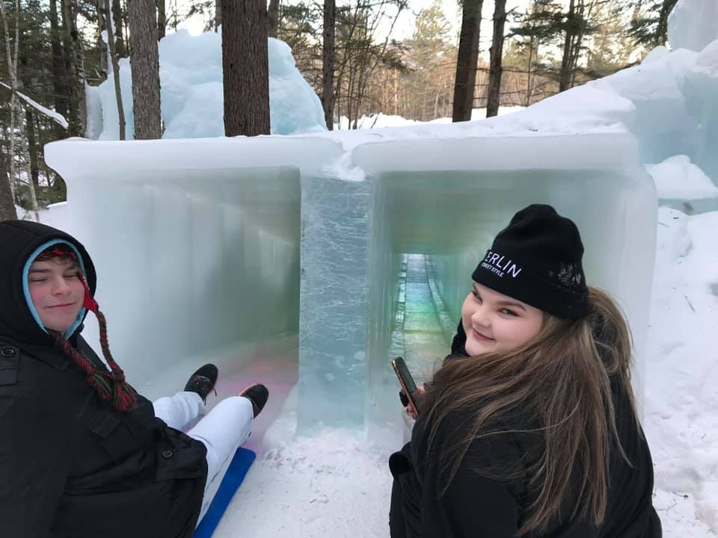
UB Winter Activities Recap
Scientist For A Day
STEM Meetings
Junior Retreat
Scholars Bowl
Movie Night
TRIO Day

Slide 4
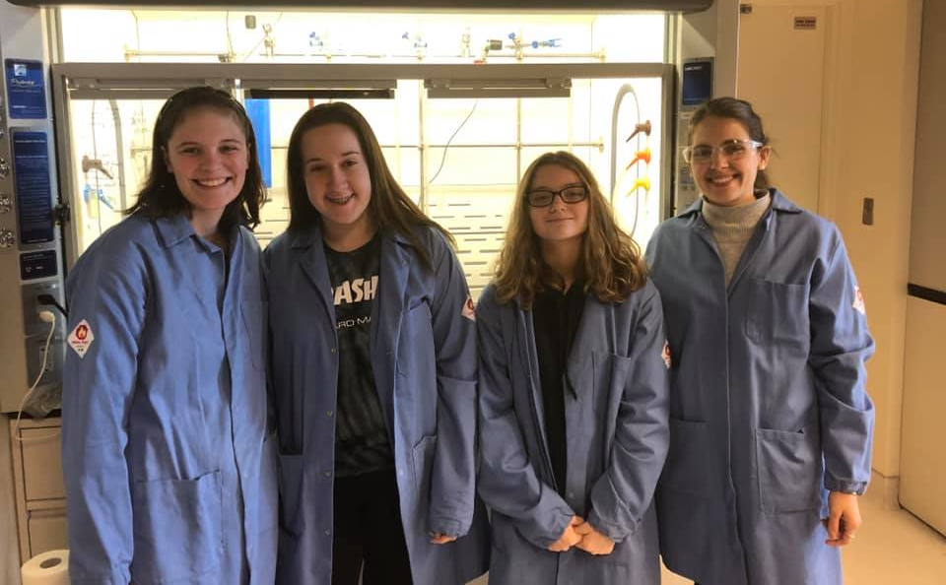
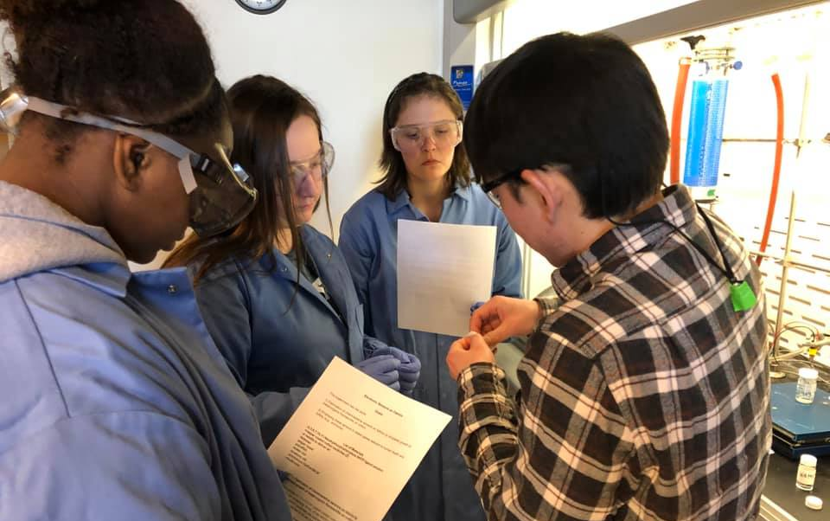
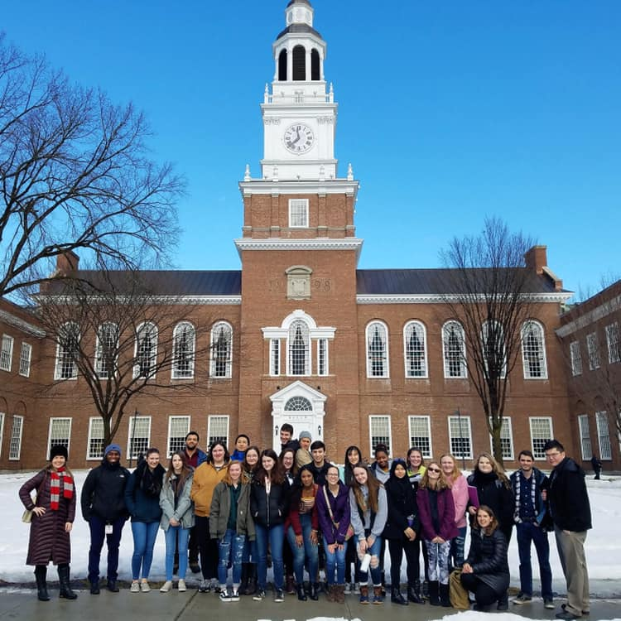
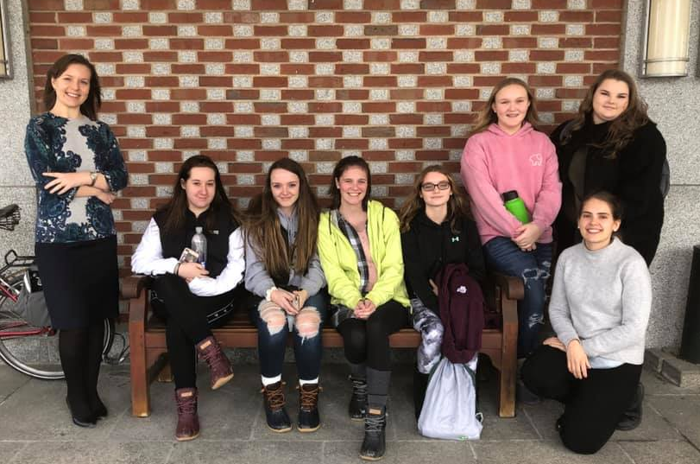
Scientist For A Day

Slide 5
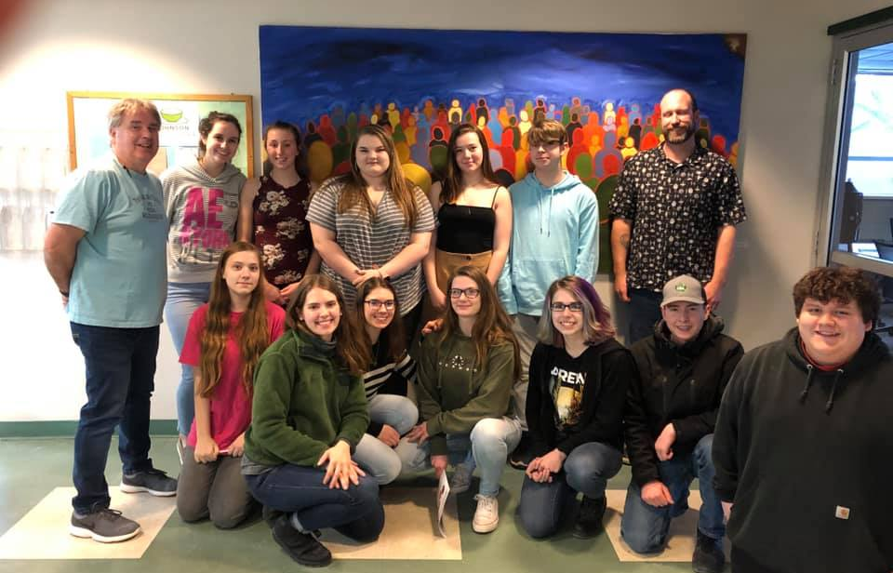
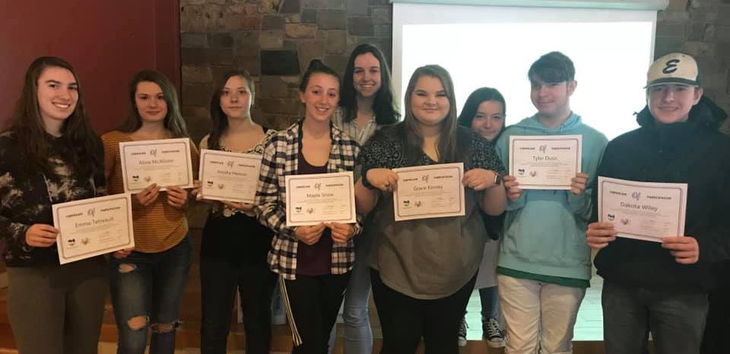
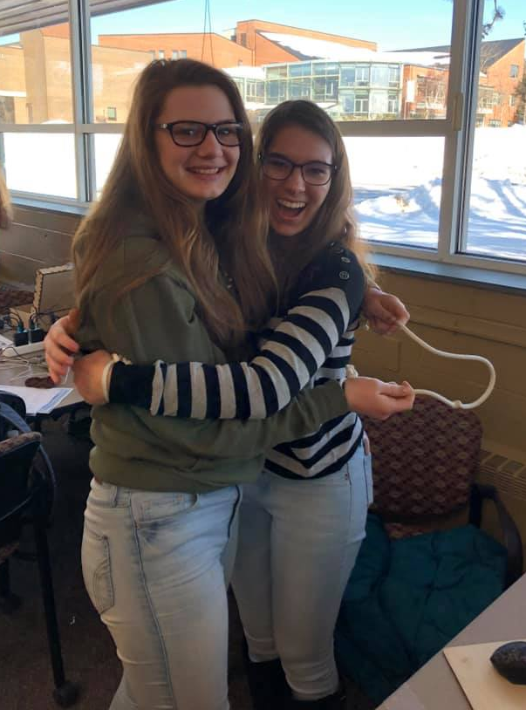
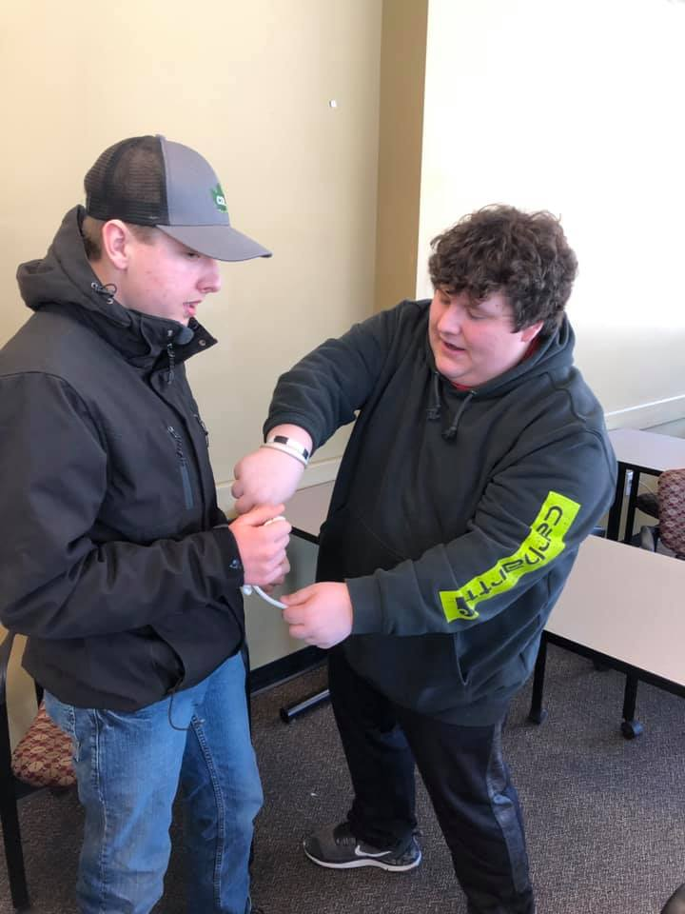
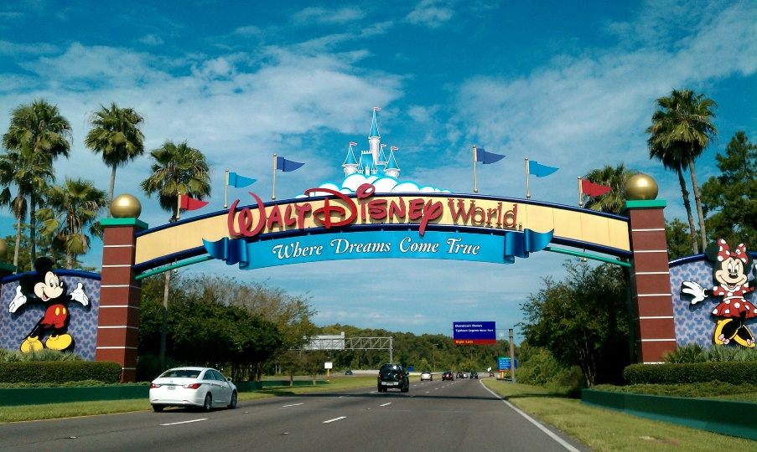
Magic of STEM Leadership Program

Slide 6
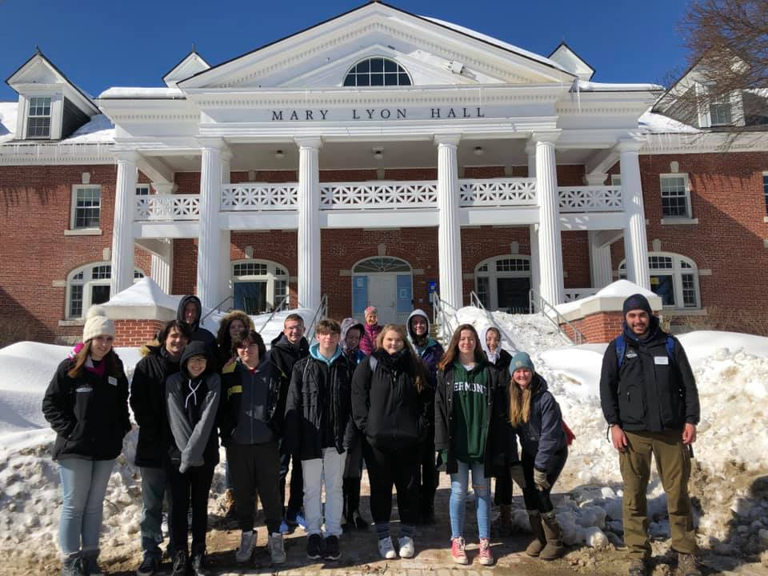
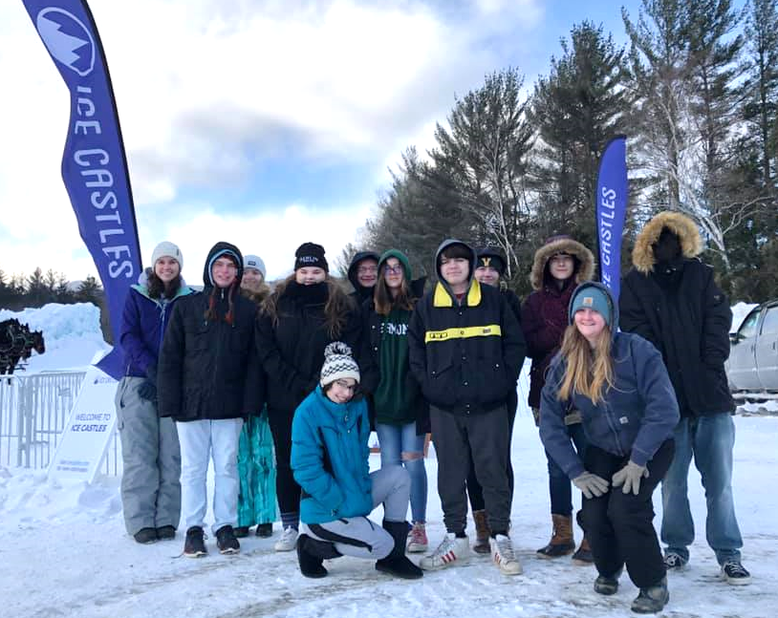
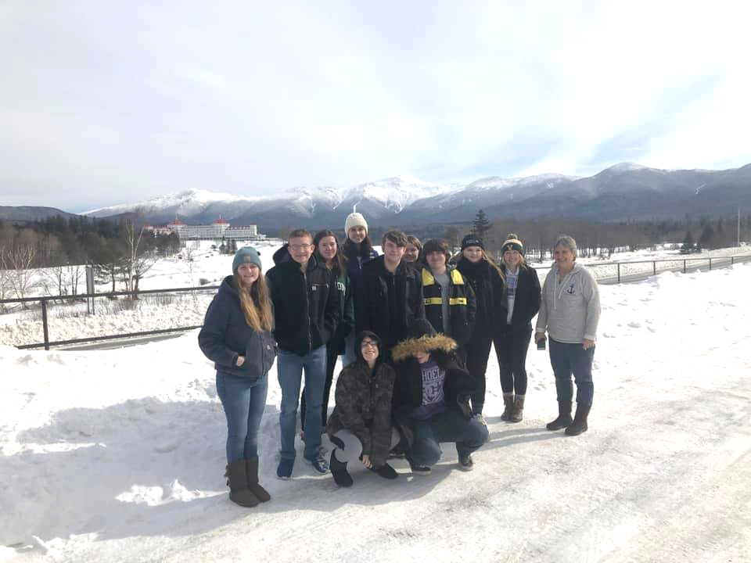
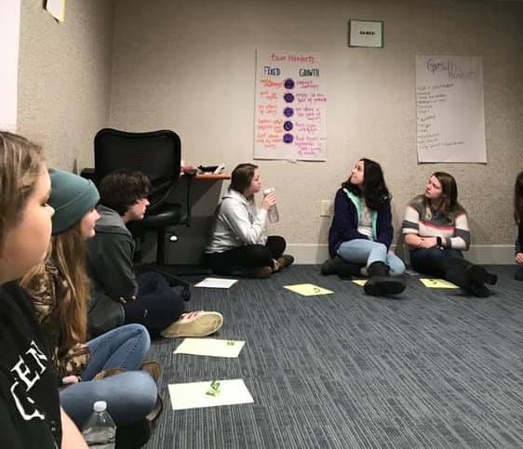
Junior Retreat

Slide 7
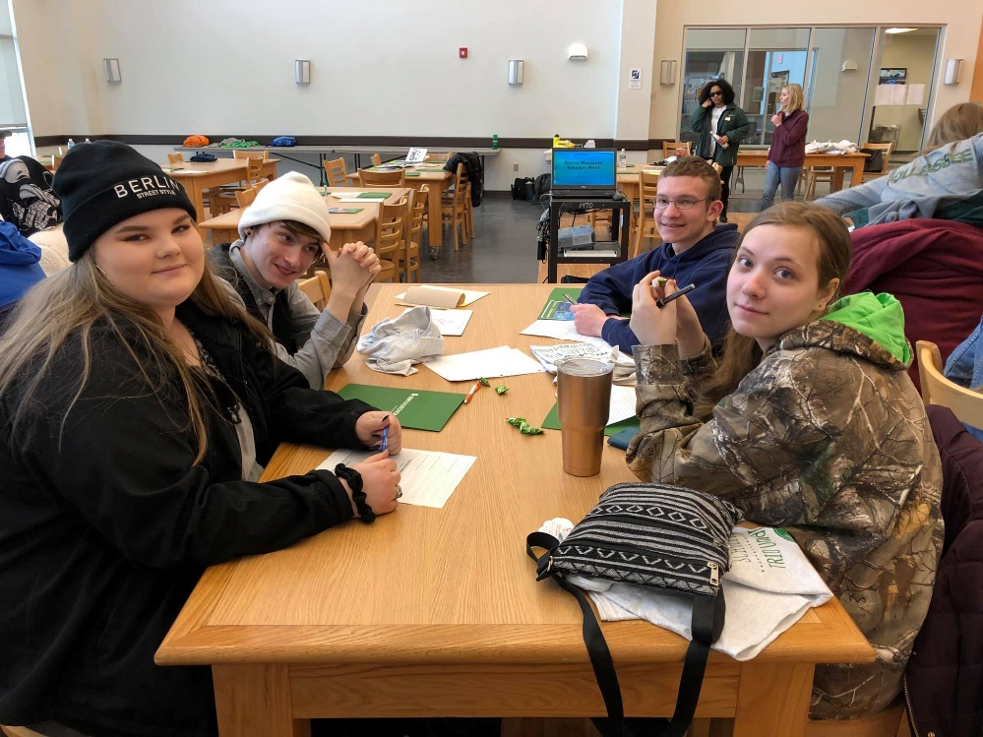
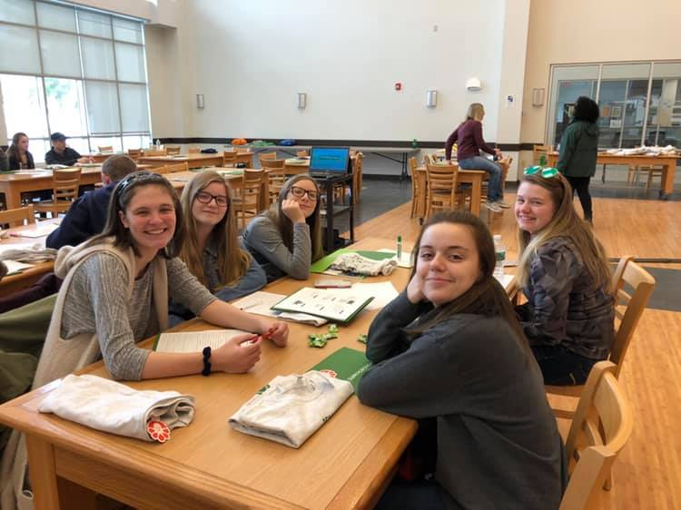
Scholars Bowl

Slide 8
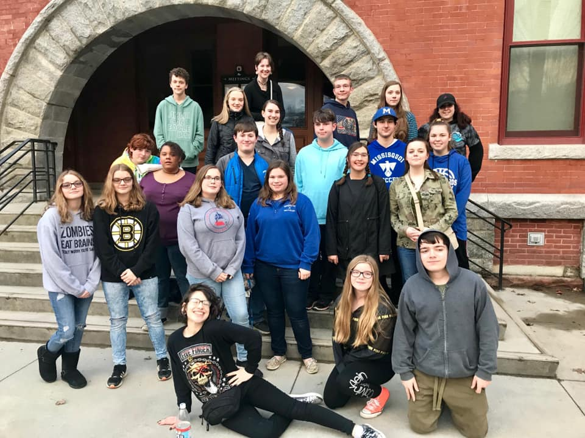
DINNER AND A Movie Night With UB
March 15th
Featuring BFA, MVU, EFHS & RHS Centers
Thank You to Your In-School Coordinators Attending

Slide 9
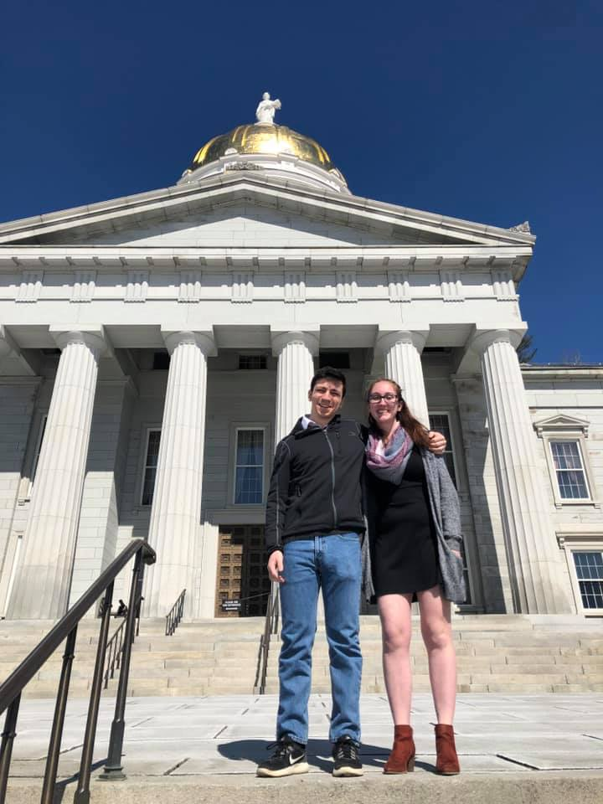
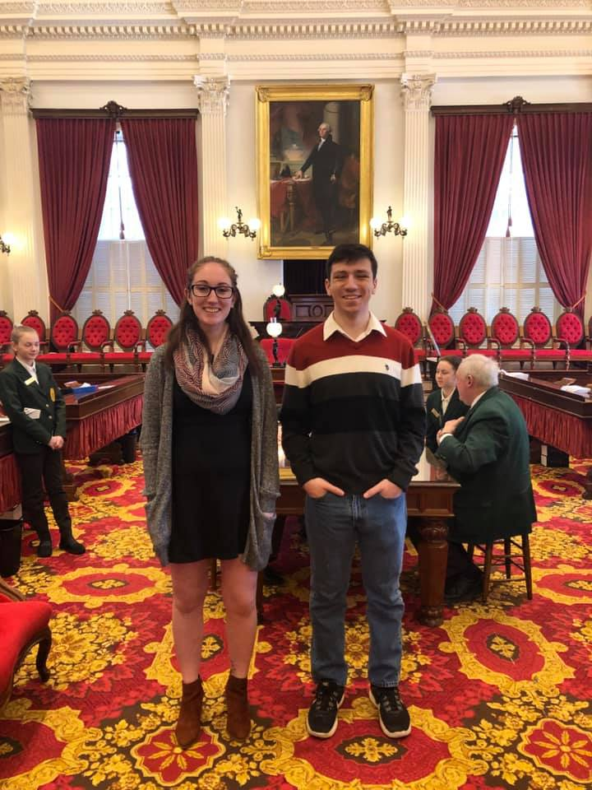
TRIO Day at VT Legislature
Held on March 19th
Representing NVU-J Erica Fuller, Nate Belanger (PA) and Olivia Leavstrom (RHS Alumni)

Slide 10
SPRING 2019 UB Events

Slide 11
BOWLING WITH UB NIGHT
WHEN: Thursday, April 4th
FROM: 5:00 -7:30 PM at Missisquoi Lanes in Lowell
Hosting the NVU-J PA, LUHS, & NCUHS Centers
Need Permission Slip to Attend
Delicious Snack Bar Dinner will be provided

Slide 12
Northeast Kingdom College Fair
Monday, April 8th, 2019
6:30 – 8:00 PM
Northern Vermont University – Lyndon
Stannard Gymnasium

Slide 13
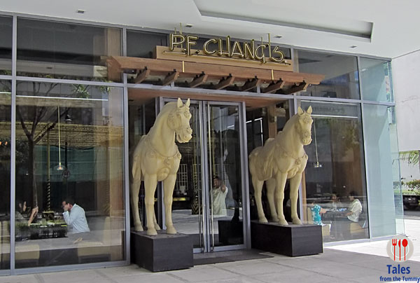
JFK Leadership Conference April 17-18
Applications Due Today!
Response to 3 questions and a permission slip !
College Tour
Doubletree Hotel Boston, MA
Special Dinner at PF Chang’s
Boston Opera House Broadway Production of Les Miserables
Leadership Conference
Say Hello to Natalee

Slide 14
Limited Seats Available
Must Be in Good Standing with Program
Permission Slips

Slide 15
May 11th -SUMMER 2019 Saturday College Kick-OFF Meeting
Welcoming All Summer 2019 Participants!
Ice Breakers & Name Games
Team Seminar Workshops
Introduction to Summer 2019
Special BBQ LUNCH on campus
Volleyball Game
Sorry, No (TEAM 4 Seniors)!
Deadline for ALL SUMMER Paperwork
Dual-Enrollment Registration must be completed

Slide 16
NVU-J UB Senior recognition Dinner
TUESDAY, MAY 14TH
6:00 – 8:00 PM
STEARNS PERFORMANCE SPACE
SENIORS - RSVP NO LATER THAN MAY 3RD FOR THIS SPECIAL EVENING HELD IN HONOR OF YOUR ACCOMPLISHMENTS

Slide 17
NVU-J Upward Bound Program….

Slide 18
STEM EXPO - NEW York Hall of Science Friday, May 17 – Saturday, May 18th
50 Partner Hosting Tables
Networking opportunities with STEM Professionals
College Representatives
Panel Discussions
Interactive Activities
Highlight Projects in STEM
Youth Intership/Leadership Opportunities
Current Partners Include:
Air Force ROTC
American Society of Naval Engineering
ASAP LaGuardia
BEAM
Binghamton University
Bronx Community College
Candogram
Clarkson Unviersity
Con Edison
CS4All
CUNY City College of Tech (Civil Engineering and Construction Management)
CUNY City College of Technology
Designers In Residence New York Hall of Science
Girl Scouts of Greater NY
Howard L. Zimmerman Architects, P.C.
Hunter College
Jamaica Medical Center
JetBlue
Mokuni Games
Museum of Interesting Things
NPower
Pursuit
Queens STEM Career Women, Inc.
Rockefeller Lab
Snapology
Society of Hispanic Professional Engineers
Spotify
STEM Modular
SUNY Maritime
SUNY Morrisville
the STUDIO
United Airlines
Vaughn College of Aeronautics and Technology

Slide 19
MARCH 30TH UB SATURDAY COLLEGE MEETING
Please enjoy your day here at NVU-J
Education by Engagement

Slide 20
Today’s Amazing Agenda
10:15am-11:30am Morning Team Workshop- (Classrooms)
Rising Team 2 (Dewey 177) w/ Matt & Sarah
Rising Team 3 (D 132) w/ Gary
Graduating Seniors (Team 4) (D1867/HTM Lab) w/ Tony
11:45am - 12:30pm Brunch (Stearns Cafeteria)
New Student Orientation Today! Lets be good representatives of UB!
12:30pm – 2:30 pm Afternoon Team Workshops
Q3 Goals Review & Complete Q4 Goals
Missing Assignments/ Portfolio Organization
Summer Enrichment & Dual Enrollment Registration
Senior Check In Time
2:30pm Closure/ Depart (Dewey Commons)

