Slide 1
Completing the Student Profile.
General overview. Check with your local Dollars for Scholars for specific instructions.

Slide 2
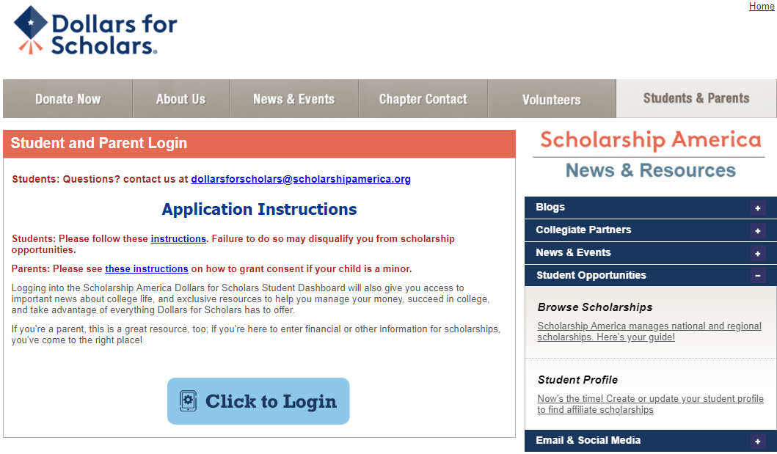
Visit ANY local Dollars for Scholars website.
Click on the student and parent tab.
Look for and follow any specific instructions provided by your local Dollars for Scholars on the web page.
“Click to Login.”

Slide 3
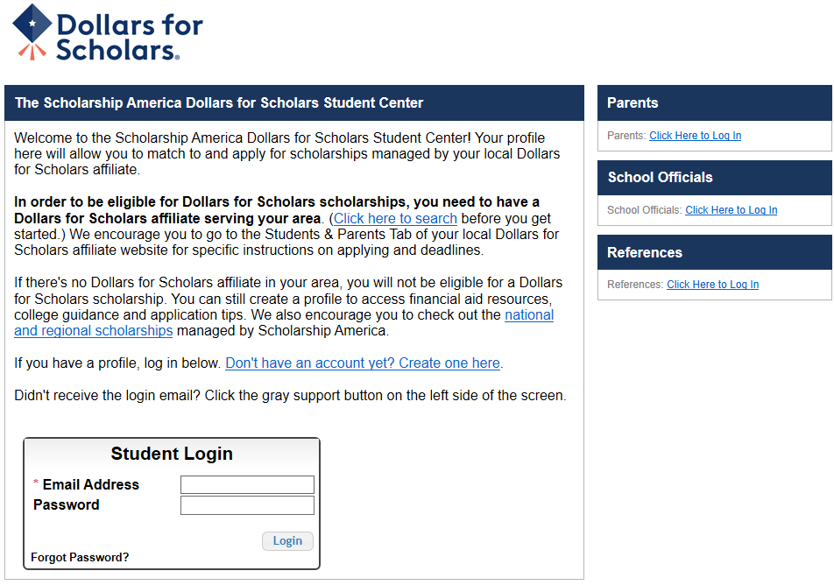
If you don’t already have an account, create one here.

Slide 4
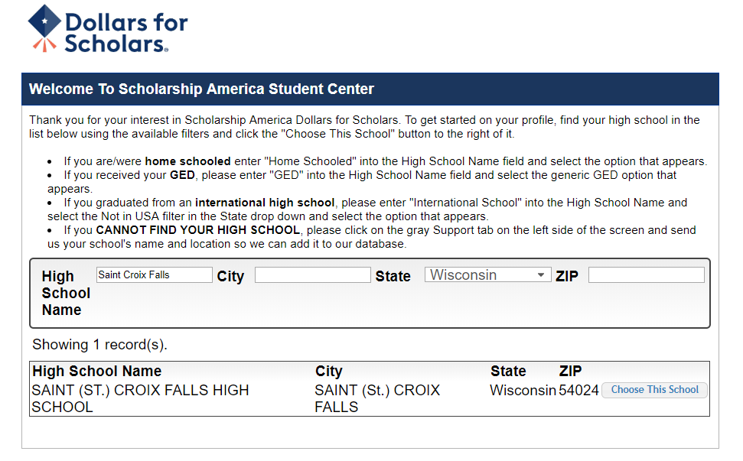
Start by entering the name of your high school.
If your school name returns too many results, you can filter by the city, state, or zip code of your school.
Click “ Choose This School” where your high school appears.

Slide 5
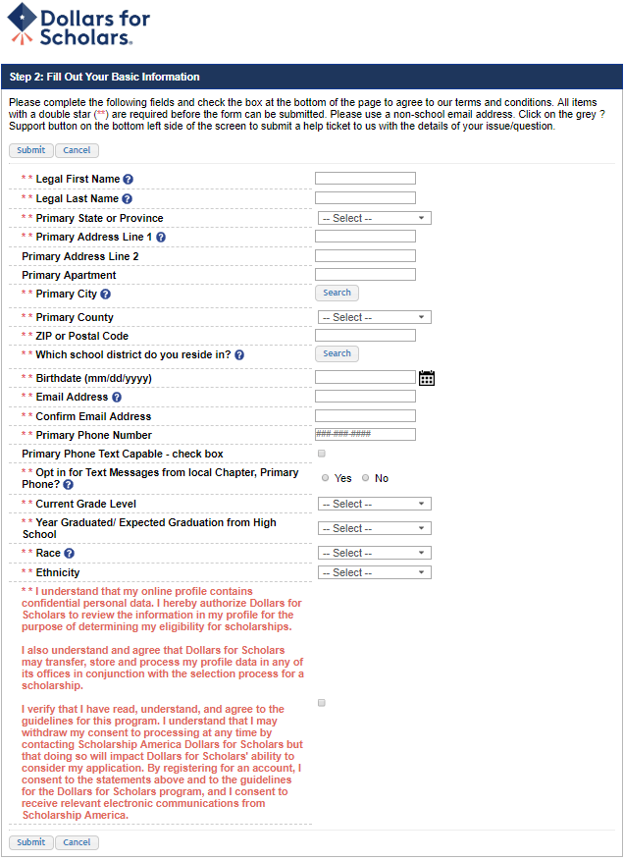
Fill in all the fields with the appropriate information.
Read the terms and conditions, check the box to agree to them, and then “Submit.”
An email will be sent to you with your login information. Check other folders (Junk/SPAM/etc.) if the email is not found in your Inbox.

Slide 6
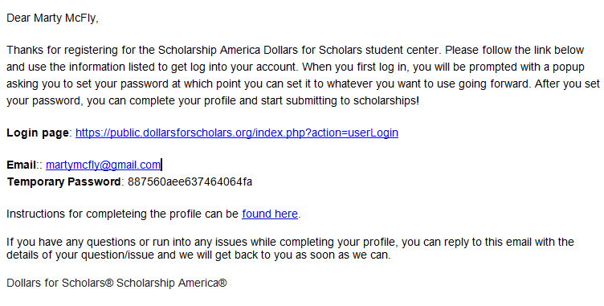
The email you receive will provide a link to the login page and a temporary password.
When you first log in, a popup will ask you to set your password. Enter the password you want to use moving forward, and click “Save Password.”

Slide 7
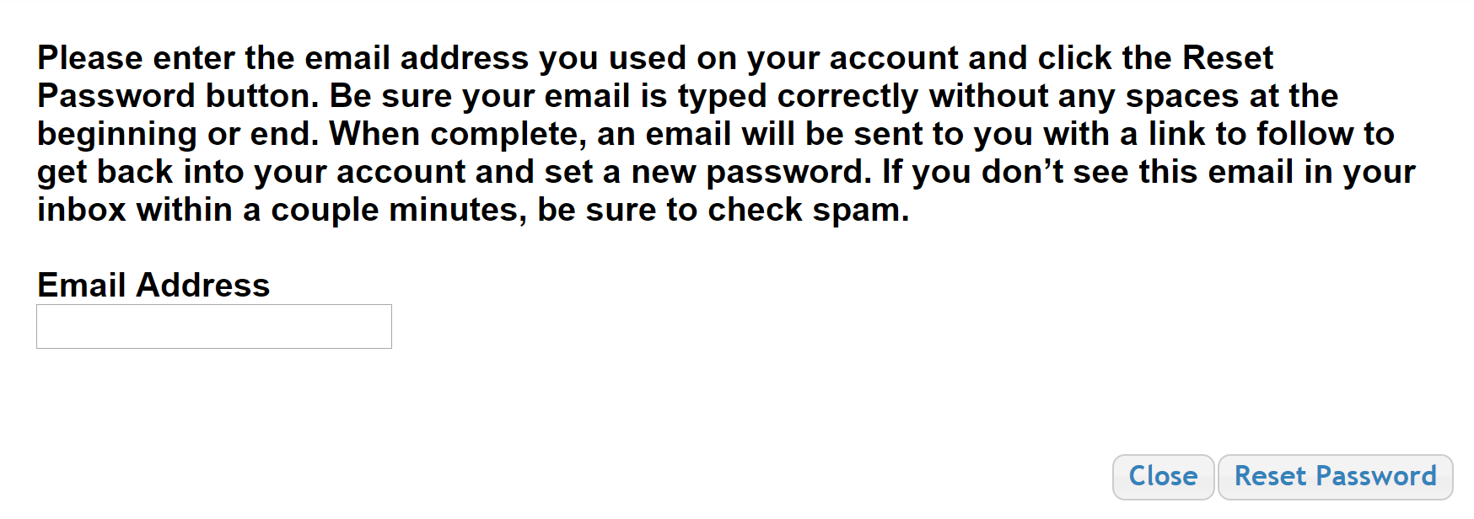
If you have forgotten your password, click “Forgot Password?”
Turn-off pop-up blockers in your browser.
Enter the email address associated with your Dollars for Scholars account.
Click “Reset Password” and an email will be sent to you with instructions to set a new password.

Slide 8
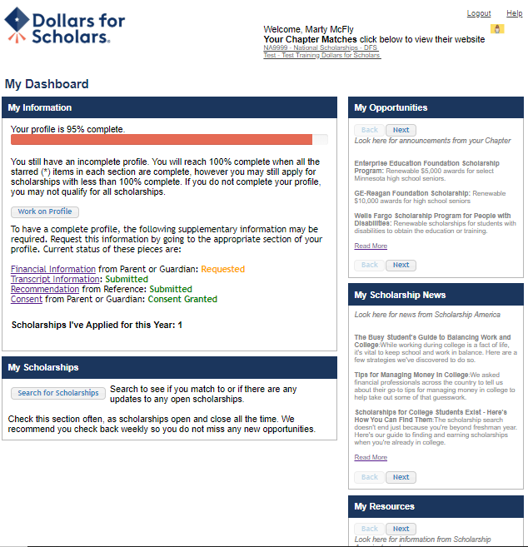
The Dashboard lets you:
View your local Dollars for Scholars under Your Chapter Matches. Click the name to be directed to their website.
My Information: View your progress and follow the link to complete your profile.
My Opportunities: View other scholarship opportunities that you may be eligible for.
My Scholarship News & My Resources: View and use other national news and resources.
My Scholarships: Search for scholarships.

Slide 9
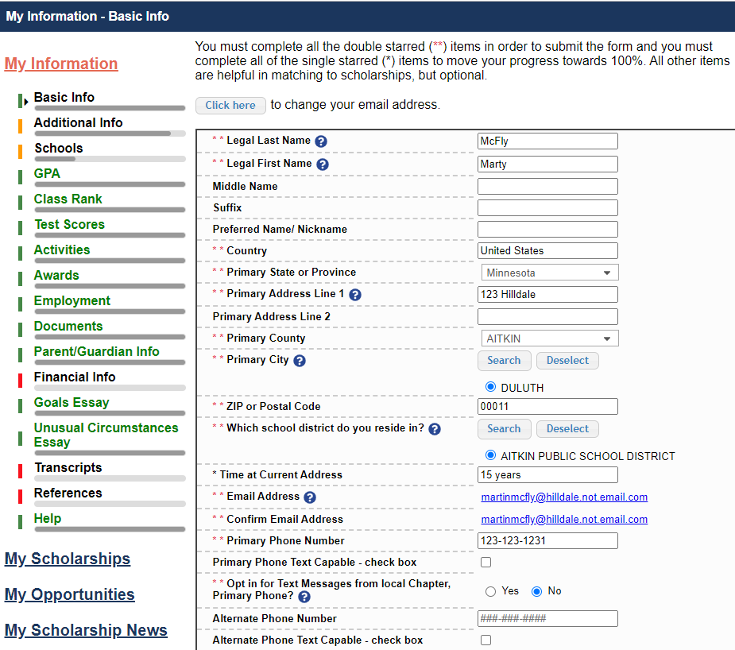
When completing your profile, notice the progress bars – The color indicates the level of completeness of each section.
Red = Not started
Yellow = Started but not completed
Green = Complete

Slide 10
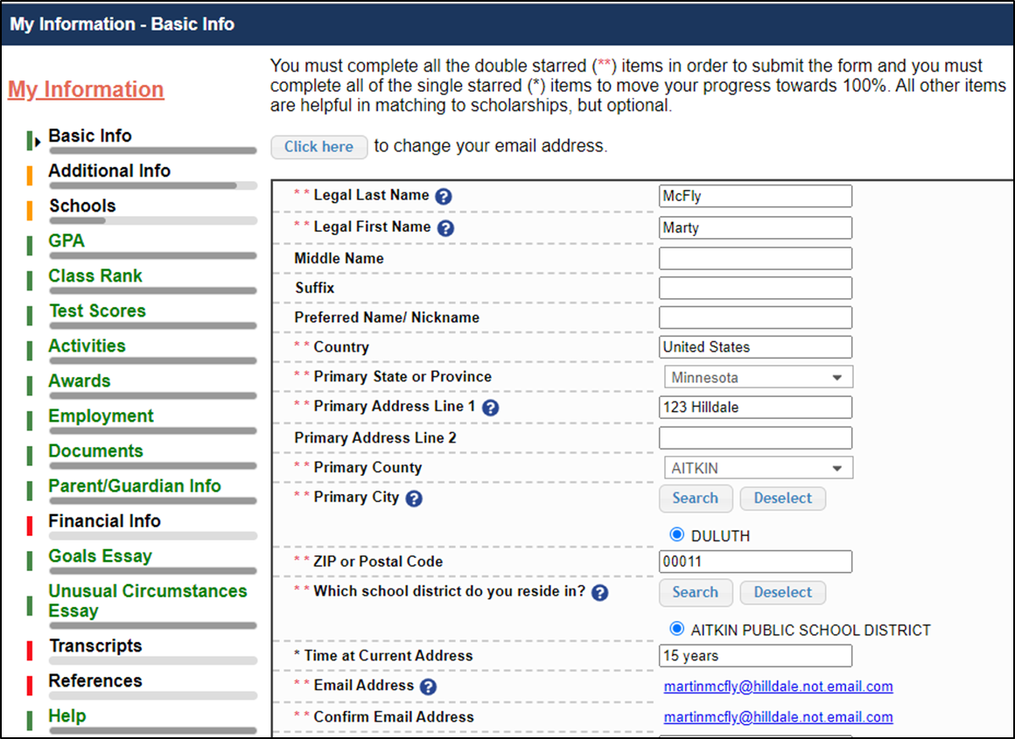
Items marked with a double ** are required to move on from each section.

Slide 11
Items marked with a single star * are factored into your profile completion percentage.
Complete all starred fields to move your profile to 100% complete.
NOTE: Being 100% does NOT mean you have applied to a scholarship.

Slide 12
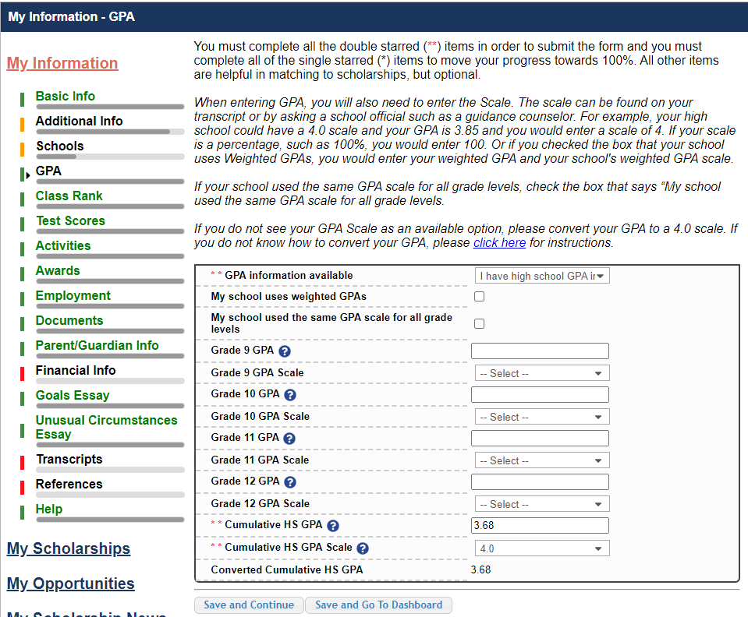
Some scholarships require GPA information.
Accuracy is important.
If you have a weighted GPA, make sure you check this box.
Enter your GPA and the GPA scale as shown on your transcript or as provided by your school official/counselor.

Slide 13
Some scholarships require Class Rank information.
Class Rank may be used along with GPA information.
If your school ranks students, select the system used.
If your school does not rank students, select “No”.

Slide 14
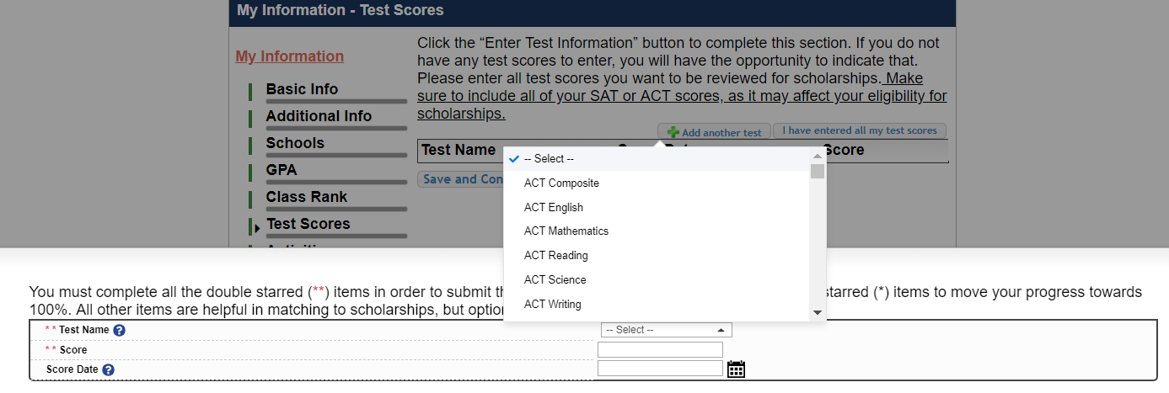
Some scholarships require test score information.
Click this button to enter all your test information.
You can enter scores for multiple tests.

Slide 15
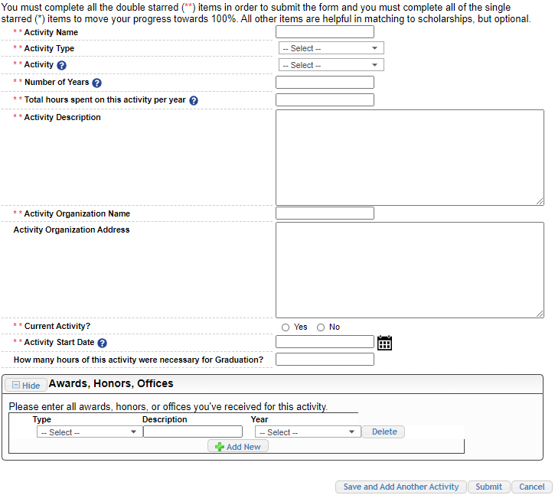
Some scholarships require Activity information. Enter all school and non-school related extracurricular activities for the last four years (church, sports, volunteering, etc.).
This Activity form appears when you click “Add an activity.”
The required fields are indicated by **.
When entering an Athletic Activity you will also need to enter a Level of Involvement.
Make sure to enter any Awards, Honors, or Offices held associated with this activity.

Slide 16
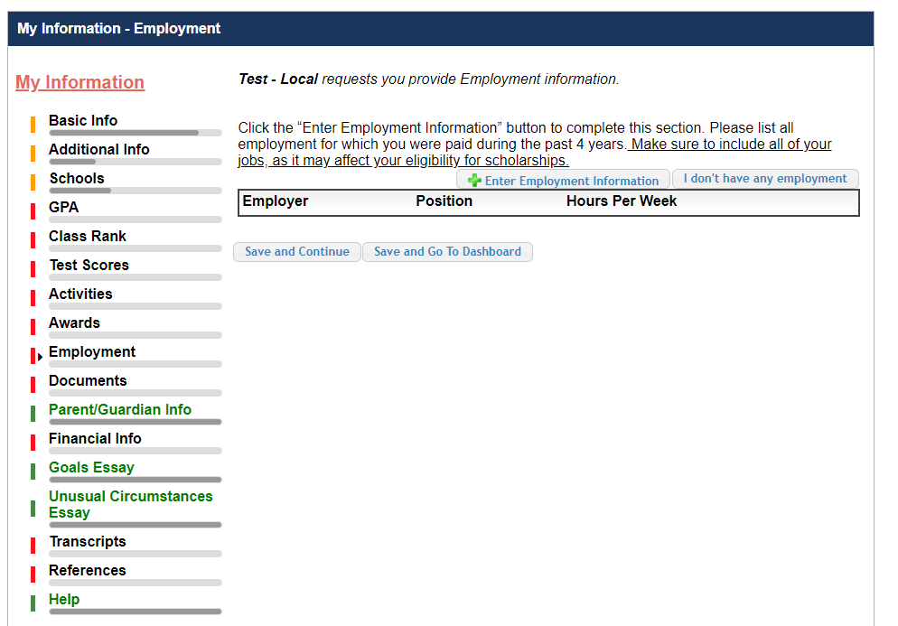
Some scholarships require employment information.
Enter all Employment history and information from the last four years.

Slide 17
Click “Enter Document Information” to upload additional application documents.
In the pop-up, enter the Document Name, select the Document Type, enter Document Description, and upload the file.

Slide 18
If you’re under 16 years old, you MUST HAVE parental/guardian consent to apply for scholarships.
Enter your parent/guardian information and request consent.
If you are 16 or older, you can still enter your parent/guardian information.

Slide 19
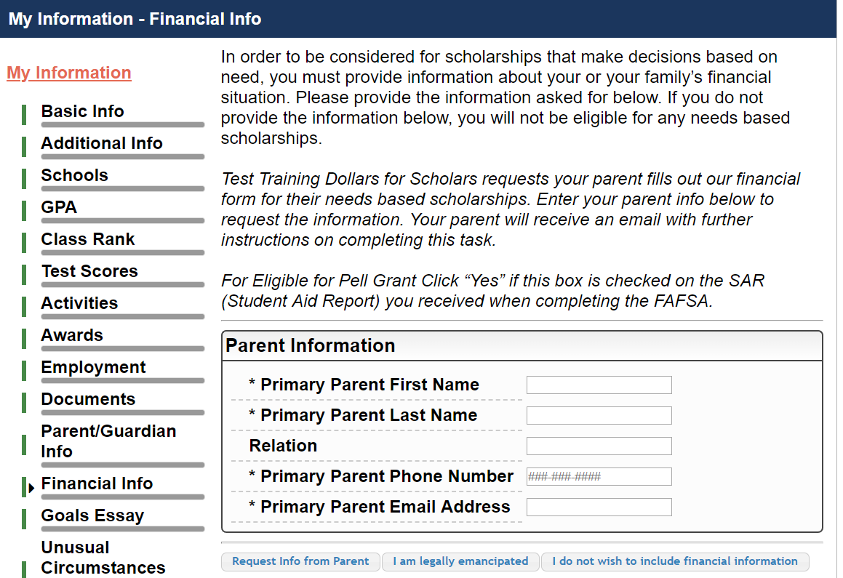
In order to be considered for need-based scholarships, you need to provide financial info.
What is shown in this section depends on what your local Dollars for Scholars requests.
You may be asked to provide your EFC,
OR
Your parent’s information so they can provide more detailed financial information,
OR
If your local Dollars for Scholars does not require financial info, the instructions will indicate this.

Slide 20
Some scholarships require a Goals and Aspirations Essay.
Provide an essay describing your plans as they relate to your educational and career objectives.
Check your local Dollars for Scholars’ website for length requirements of the essays. If no instructions are provided, there is no length requirement.

Slide 21
Some scholarships require an Unusual Circumstances Essay
Provide an essay describing how and when any unusual family or personal circumstances affected you.
Check your local Dollars for Scholars’ website for length requirements of the essays. If no instructions are provided, there is no length requirement.

Slide 22
Some scholarships require a transcript or verified transcript information.
Click “Add School Official Information” to request your transcript information.
If you are a college student, you will be prompted to upload your own college transcript.

Slide 23
Some scholarships require a recommendation.
Click “Add Reference Information” to request your recommendation.

Slide 24
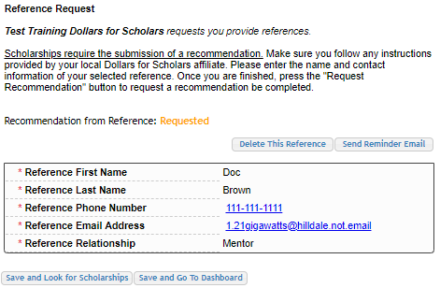
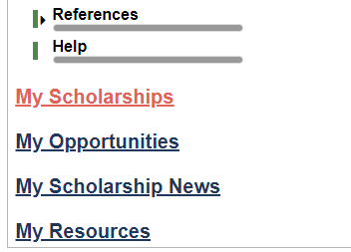
Now search for scholarships!
Click “Save and Look for Scholarships” on the References page.
Click “Search for Scholarships” on My Dashboard.
Click “My Scholarships” in the menu on any page.

Slide 25
Applying for Scholarships

Slide 26
On the My Scholarships page, your Dollars for Scholars may have additional questions you need to answer to verify your eligibility for scholarships.
Not all Dollars for Scholars have these types of questions.

Slide 27
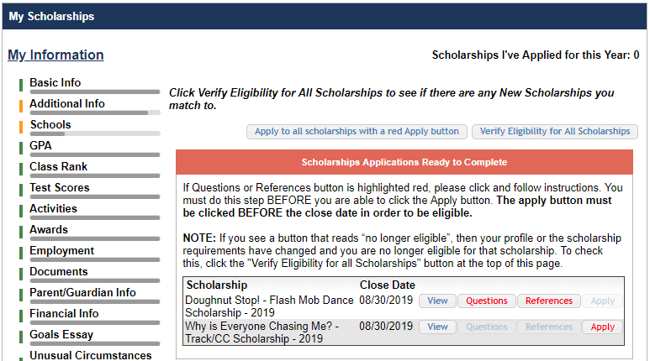
Some Dollars for Scholars require additional open-ended questions and/or additional references.
Click the active Questions and/or References buttons to complete the additional information.
As with the previous screen, your Dollars for Scholars may or may not have these additional questions or references.

Slide 28
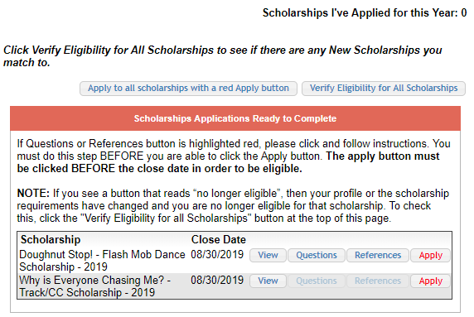
Additional question or reference information may be required before submitting an application for certain scholarships. The “Apply” button will activate only after these are complete.
If no further information is required, the “Apply” button will already be active.
To be eligible for a scholarship, you MUST click “Apply.”

Slide 29
Check out the Help section for Frequently Asked Questions.
If you have any questions not answered here or need technical assistance, contact the Support team.

Slide 30
You can get back to your profile at any time via “Click to Login” on your Dollars for Scholars’ Students & Parents page.

