Slide 1
Essential Information regarding THDFS Scholarships
These slides address:
Essays: See Slide 2: these essays are to be done only if applying for National Scholarships.
Transcripts See slide 3
Teacher Reference: Slide 3 (required)
Finding Scholarships: Slides 4, 5, 6
THDFS Essay (required) See slide5
THDFS Community Reference (required) See Slide 5
How to submit for the Taconic Hills Dollars Scholarship. See Slide 5 (required)
(It is THE most important thing to do!!!)
Help is available for ANY questions by emailing us at taconichillsdfs@@outlook.com
Contact us with any questions, access issues or difficulties with references. We are here to help!
Deadline is Midnight March 8, 2019
DO NOT WAIT UNTIL THE LAST MINUTE TO DO THIS!

Slide 2
Student Profile: Essays
Goals and Aspirations Essay. This is NOT required for THDFS. It is needed only if applying for National Scholarships.
Unusual circumstances Essay is NO LONGER required by THDFS in this section. It is only if applying for National Scholarships.

Slide 3
Student Profile: Transcripts & References
Submit your transcript request now: Do NOT worry if it is not done by 3/8/19.Guidance will get to it.
kcarlo@taconichills.k12.ny.us
dsolimando@taconichills.k12.ny.us
priscavage@taconichills.k12.ny.us
soles@taconichills.k12.ny.us
Information on GPA and Class Rank will not be available until mid-February. We will announce it on our Facebook and Instagram Page when the numbers are ready.
Click to add reference information to request a recommendation. MUST be a Taconic Hills or Questar Teacher! Ask first before using them! Do this item now!

Slide 4
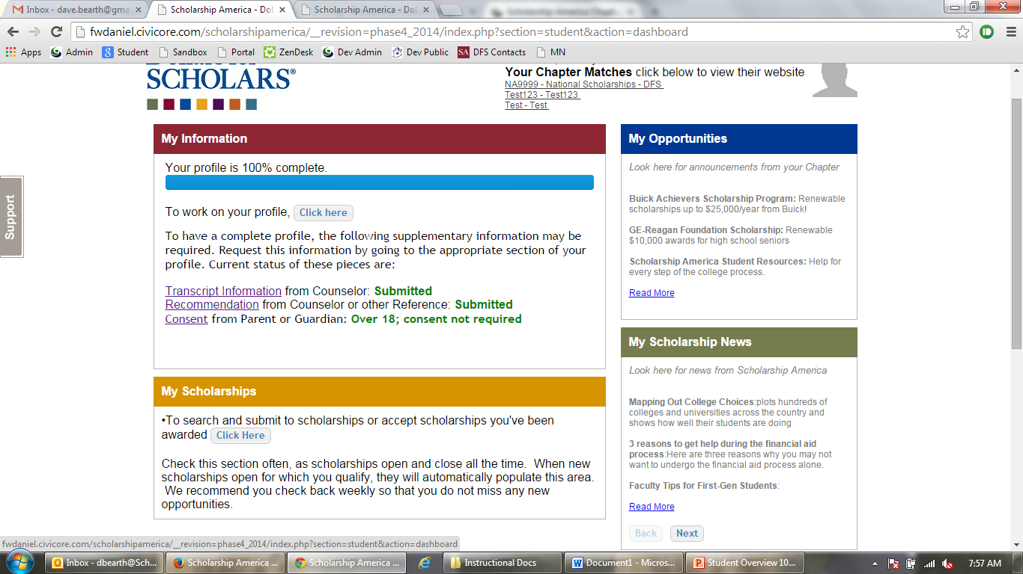
Student Profile: Finding Scholarships
Click to find THDFS Scholarships. It will ask you several questions about what Fire District you live in. The listed Fire Districts may or may not have scholarships in a given year, but we ask just in case! Answer each one yes or no. Click submit and see the next slide
Ignore any OTHER chapters that may appear.

Slide 5
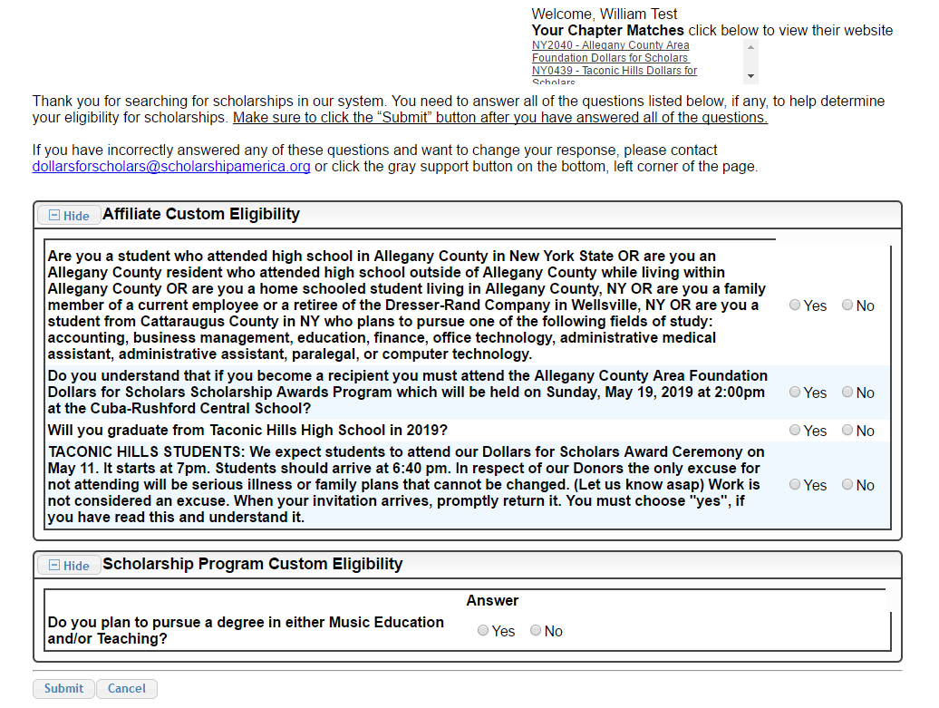
Answer BOTH questions about Taconic Hills!
The access to scholarships will not well without “yes” to each question.
Ignore questions about other Chapters

Slide 6
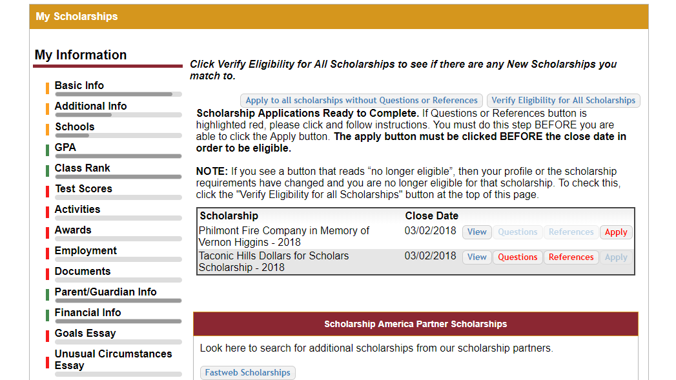
Accessing A THDFS Scholarship
Once you have answered ALL of the questions, you will now see the Taconic Hills Dollars for Scholars Scholarship 2018.
Click on the Questions tab. THIS is the essay that we require for your THDFS Application. THIS one is used to to apply for local THDFS Scholarships.
Click on the Reference Tab: You MUST do this reference (any community member that is not a family member: ask first)
After you are completed with the THDFS Scholarship (essay and reference) then click the apply button to submit for the THDFS Scholarship 2019! We need you to do this (See RED circle). It will be red on your page. Again, not all scholarships are visible. The Committee will do the matching for you based upon the completed application.
Also click submit for any Fire Company Award you may qualify for.

Slide 7
Scholarship Matches
This is where National Scholarships will appear. As you complete the application, some may show up. The more complete your application the more that may appear. Take the time to accurately fill in every tab through the application. Your information is automatically cross referenced by Scholarship America.

