Slide 1
Instructions for applying for scholarships via Dollars for Scholars Student Center

Slide 2
Helpful Hints
Complete your profile completely and accurately. You will match to more scholarships if you provide complete information.
Check back frequently to see if you qualify for additional scholarship opportunities. New scholarships are added periodically.
Make sure your Transcript and Reference information has been submitted before selecting “Apply” for any scholarships.
Transcript Requests – send these to Karen Jones; kjones@warriors.winnacunnet.org
Recommendation Requests – send these to Melinda Shofner; shofner@warriors.winnacunnet.org
If you are under 18, your parent will need to provide consent. This process is explained during the application process.
Winnacunnet Dollars for Scholars uses FAFSA EFC number for scoring applicants for scholarships based on financial need. Your parents DO NOT need to supply any other financial information for you to qualify for Winnacunnet Dollars for Scholars scholarships. However, if you do not provide FAFSA EFC information you will be unable to qualify for scholarships requiring demonstration of financial need.
Questions? Email us at WinnacunnetDFS@gmail.com

Slide 3
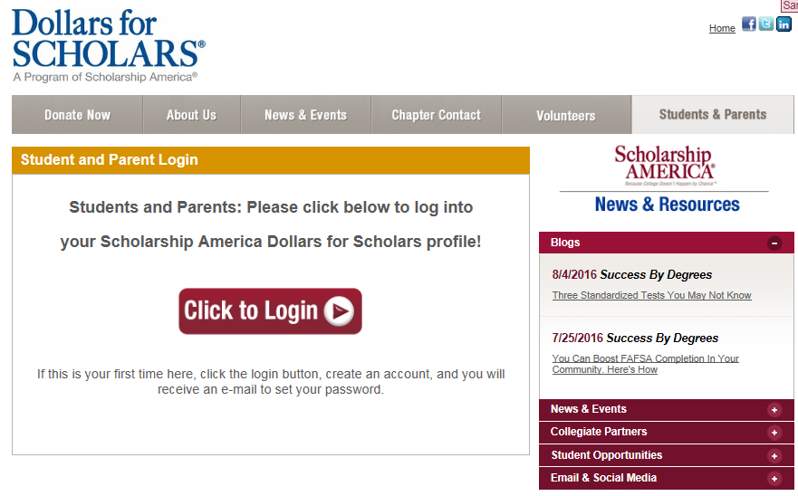
Creating Your Profile www.winnacunnet.dollarsforscholars.org
Go to www.winnacunnet.dollarsforscholars.org
Click on the student and parent login tab.
Look for any specific instructions on the web page.
Click the red “Click to Login” button.

Slide 4
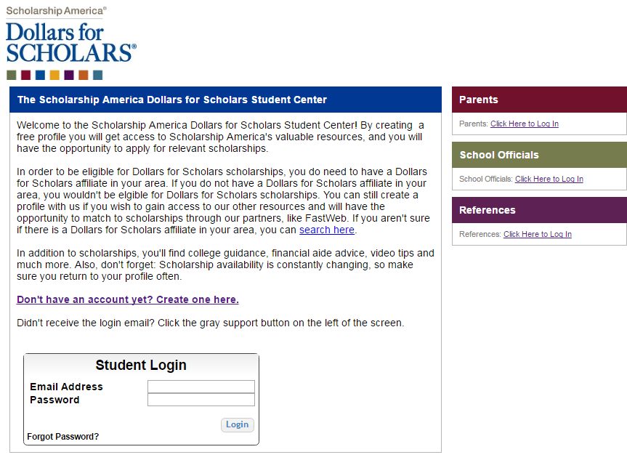
Creating Your Profile
If you are a new student, create your account here.
If you already have an account, log in here.

Slide 5
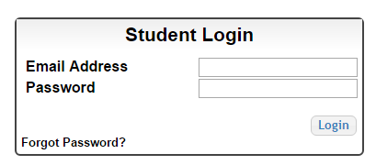
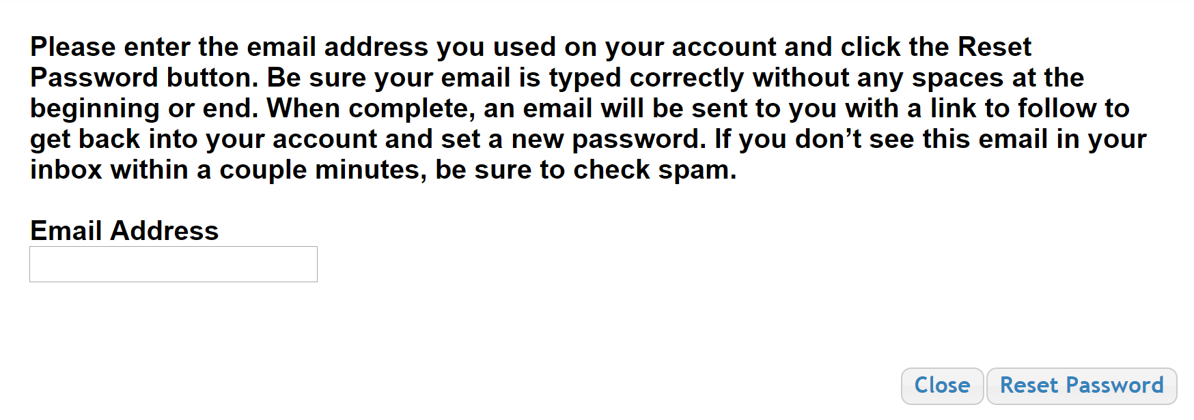
Creating Your Profile
If you have forgotten your password, click on the Forgot Password? link.
In the pop-up, enter the email address associated with your Dollars for Scholars account.
Click the Reset Password Button and an email will be sent to you with instructions to set a new password.

Slide 6
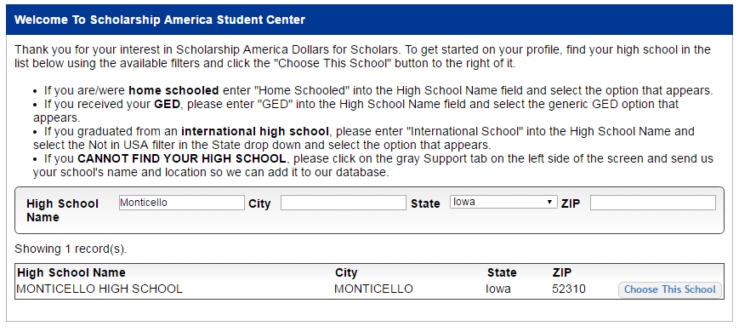
Creating Your Profile
Enter “Winnacunnet” as your high school name.
Click on “Choose This School” where your high school appears.

Slide 7
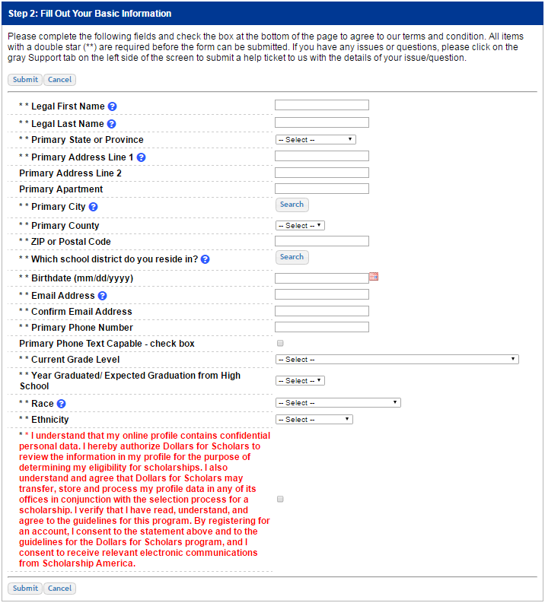
Creating Your Profile
Fill in all the fields with the appropriate information.
Read the terms and conditions, check the box to agree to them, and then click the submit button.
An email will be sent to you with your login information. Check SPAM if you don’t see the email in your inbox within a few minutes.

Slide 8
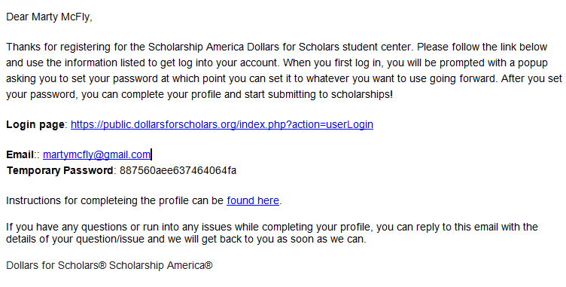
Email and Login Info
The email you receive will provide you a link back to the login page as well as a temporary password for logging in.
When you first log in using the information provided, you will be prompted with a popup asking you to set your password. Enter the password you want to use going forward, and click on the “Save Password” button.

Slide 9
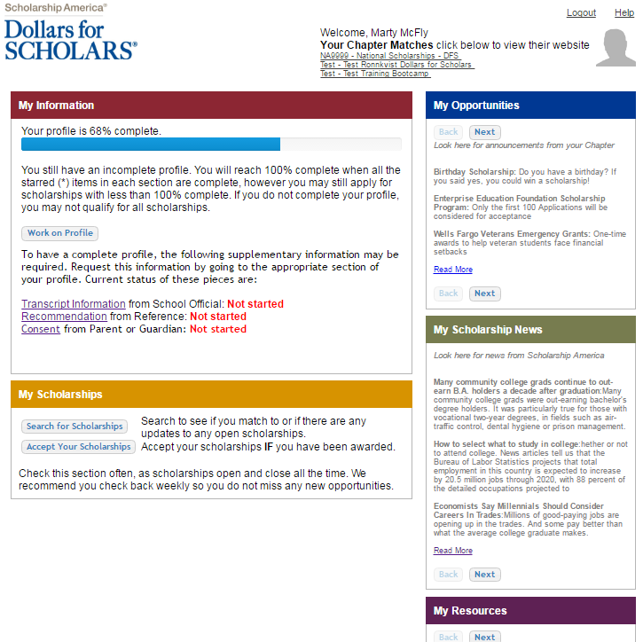
Welcome to the Student Dashboard!
The Dashboard lets you:
View Dollars for Scholars affiliates you match to. If you click the name, it will direct to websites.
View your progress and follow the link to complete your profile.
View other scholarship opportunities that you may be eligible for.
View and use other national news and resources.
Search for scholarships!

Slide 10
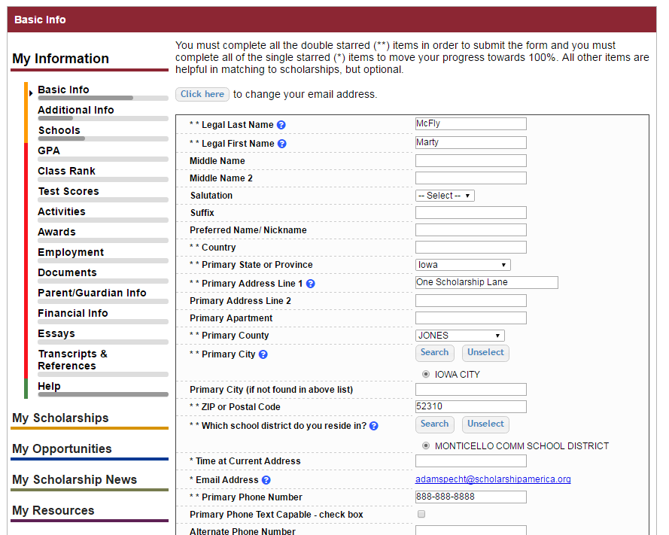
Your Student Profile
When following the link to work on your profile, you will be taken to Basic Info, the first section of your profile.
Notice the progress bars - the color matches your level of completeness.
n Red = Not started
n Yellow = started but not finished
n Green = Complete

Slide 11
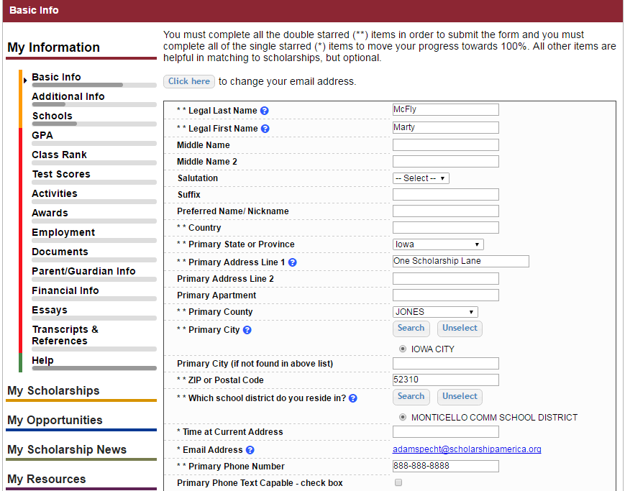
Student Profile: Basic Information
Items marked with a double star ** are required to move on from each section.

Slide 12
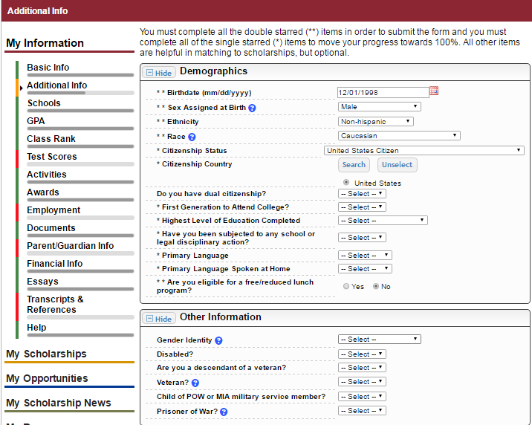
Student Profile: Additional Information
Items marked with a single star * are part of your completion percentage.
Complete all these fields to move your profile to 100% completion.

Slide 13
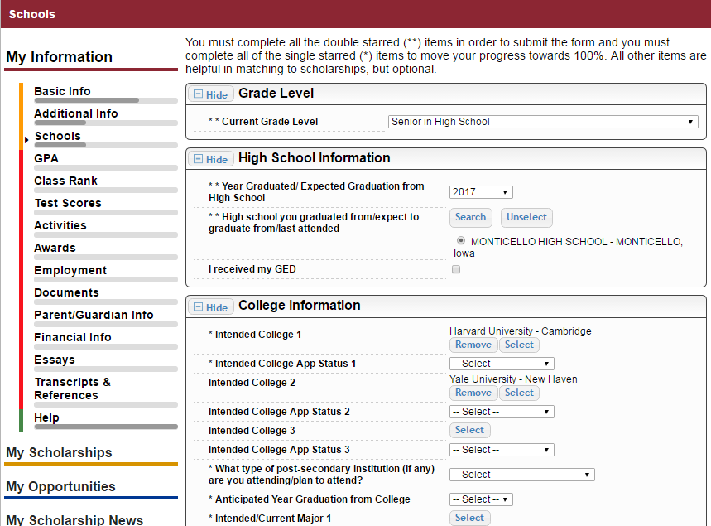
Student Profile: Schools
Be complete and accurate!
Doing so will lead to more scholarship opportunities.

Slide 14
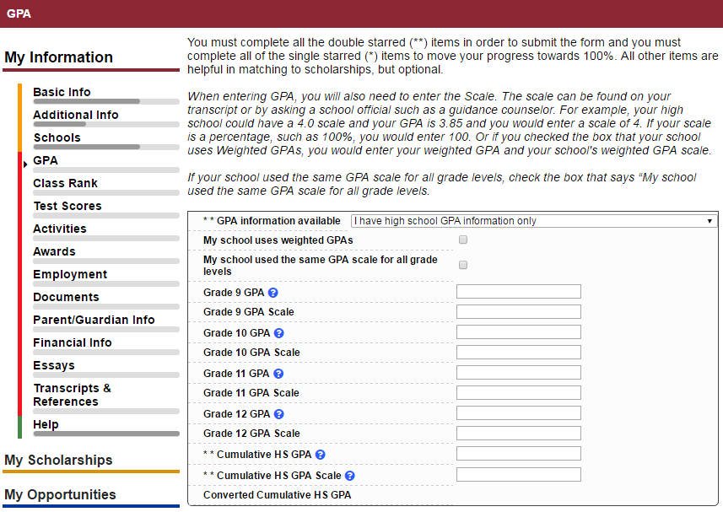
Student Profile: GPA
Accuracy is important! Data will be compared to your transcript.
If you have a weighted GPA, make sure you check this box.
Enter your GPA and the GPA scale as shown on your transcript.

Slide 15
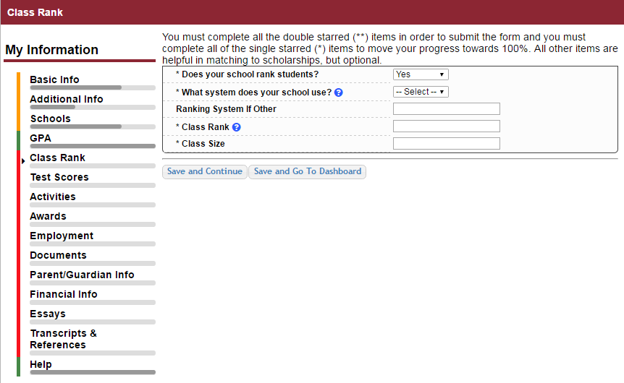
Student Profile: Class Rank
Class Rank is used along with GPA information.
If your school ranks students, you will need to indicate the system used
If your school does not rank students, select “No.”

Slide 16
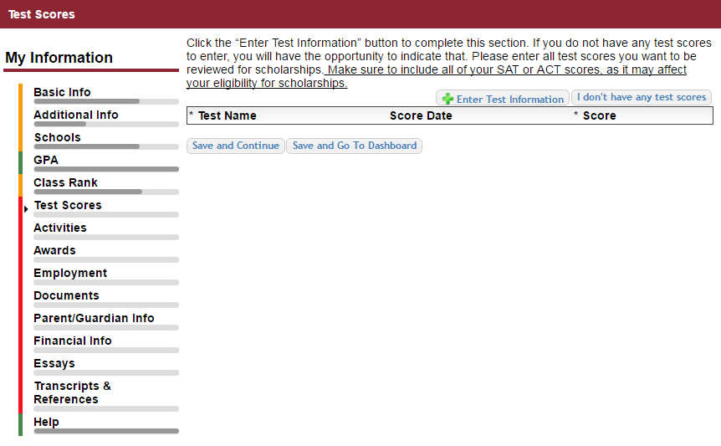
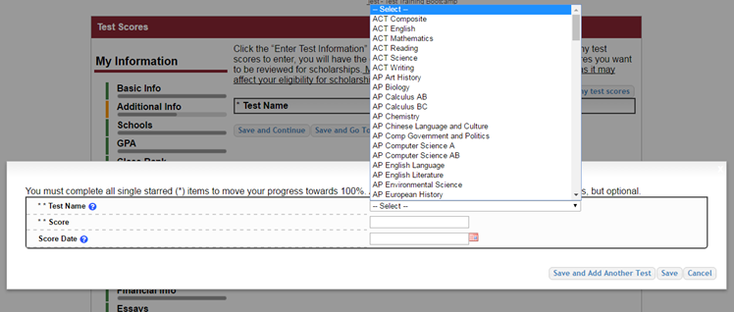
Student Profile: Test Scores
Click this button to enter ALL your test information!
You can enter multiple tests and save to add more later.

Slide 17
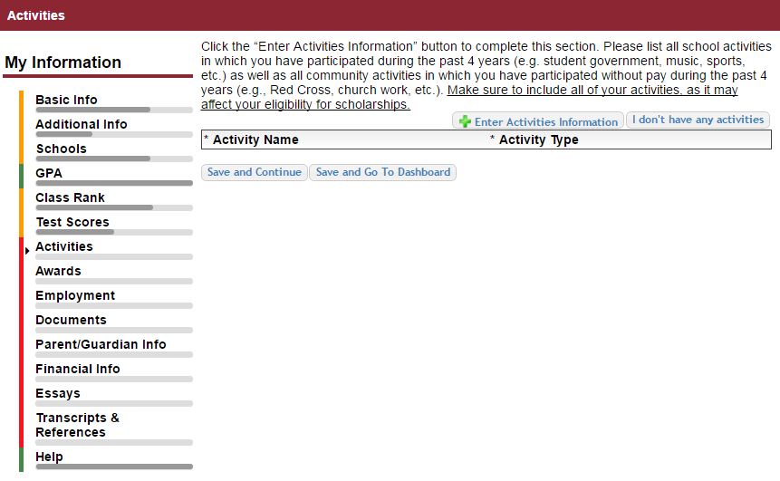
Student Profile: Activities
Enter ALL school and non-school related extracurricular activities for the last four years (church, sports, volunteering, etc.).
Scoring depends on the completeness of your profile.

Slide 18
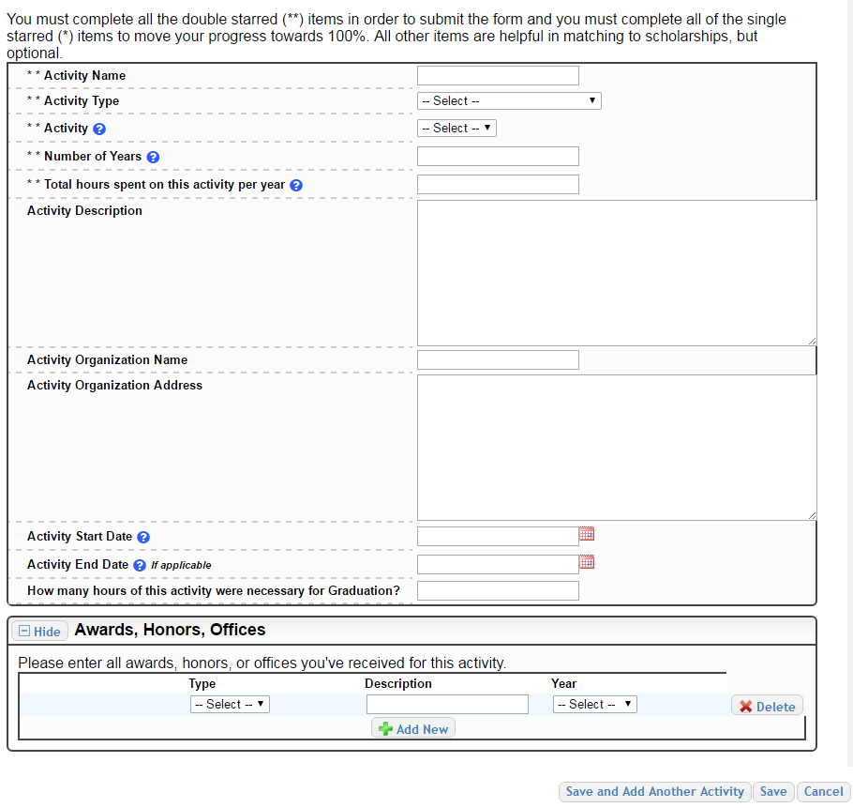
Student Profile: Activities
This Activity form appears when you click to add an activity.
The required fields are located at the top, indicated by **
Activity Description, Organization Name, and Organization Address are helpful in determining your involvement in the activity.
Make sure to enter any Awards, Honors, or Offices held associated with this activity.

Slide 19
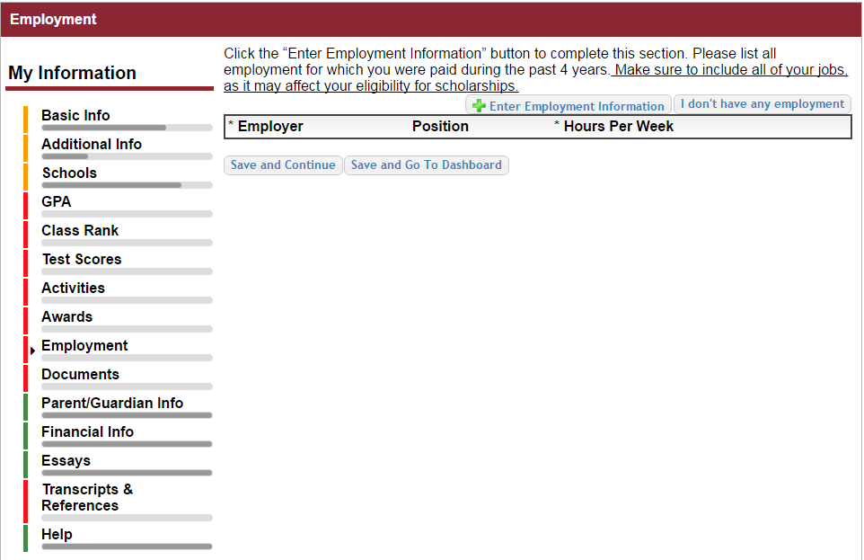
Student Profile: Employment
Enter ALL Employment history and information from the last 4 years.
Scoring depends on the completeness of your profile.

Slide 20
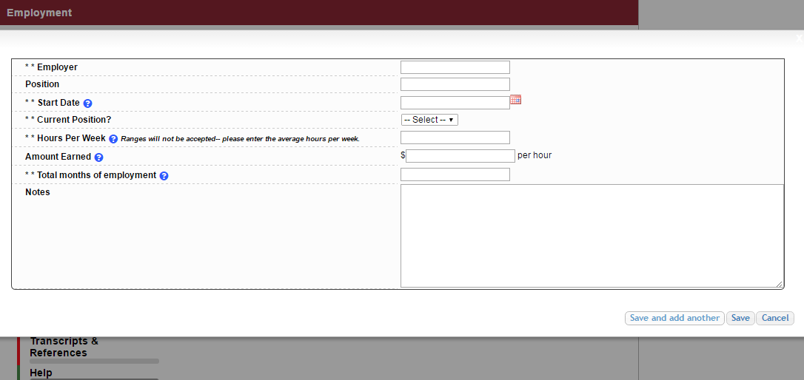
Student Profile: Employment
Enter all your employment information for the last four years.
For questions on how to complete a field, hover over the blue ? bubble for that line.

Slide 21
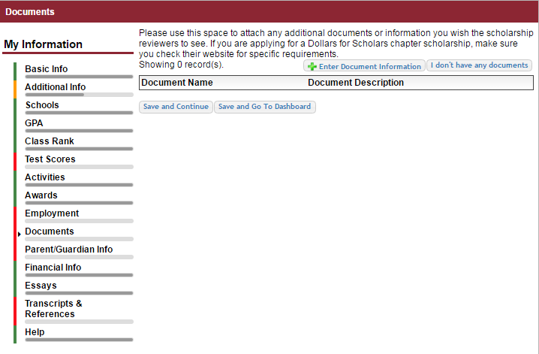
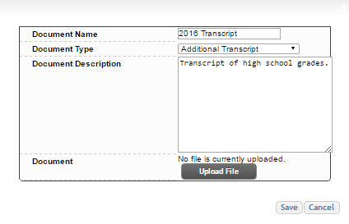
Adding additional documents
Click on the Documents section to add additional documents.
Next, click on “Enter Document Information.”
Add the document name, type, description and then upload the file.

Slide 22
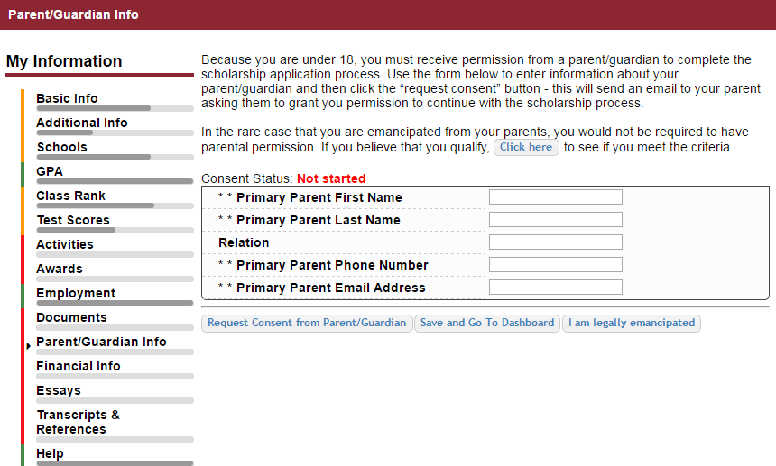
Student Profile: Parent/Guardian Information
If you’re under 18, you need parental consent to apply for scholarships.
Enter your parent information and request consent.
If you are over 18, you do not need consent but can still enter your parent information.
If you are legally emancipated, you can click here.

Slide 23
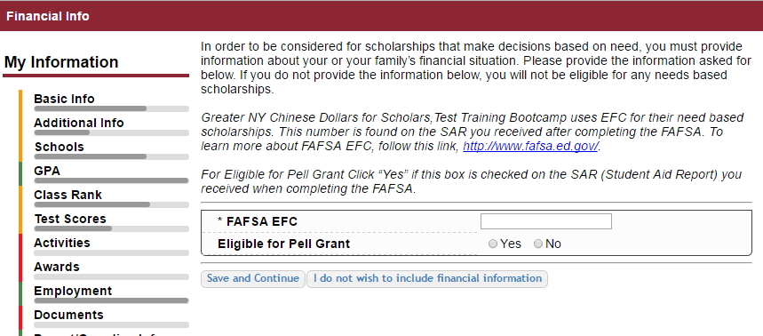
Financial Information
In order to be considered for need-based scholarships, you need to provide financial info.
What is shown in this section depends on what your matching Dollars for Scholars affiliate(s) requests.
You may be asked to provide your EFC, or
Your parent’s information so they can provide more detailed financial information.
If your matching affiliate(s) do not require financial info, the instructions will inform you of this.

Slide 24
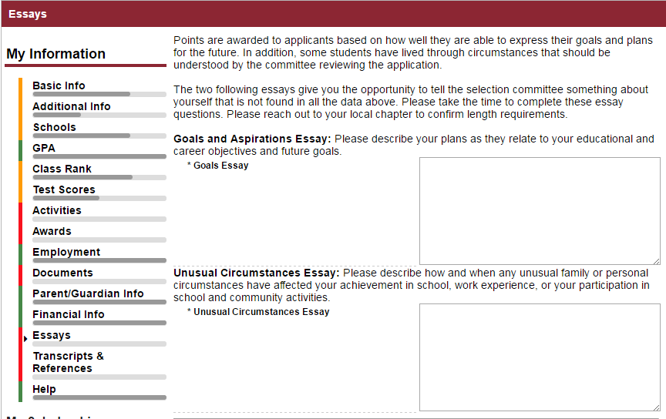
Student Profile: Essays
Provide an essay on your goals and aspirations.
Provide an essay on any unusual circumstances or challenges you may have experienced in your life.
Confirm with your local Dollars for Scholars affiliate on the required length of the essays.

Slide 25
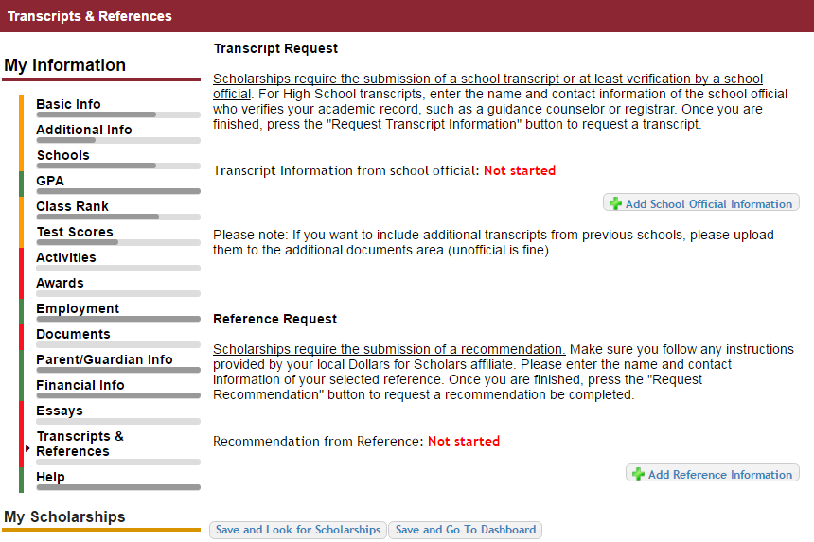
Student Profile: Transcripts & References
Click “Add School Official Information” to request your transcript information.
Click “Add Reference Information” to request your recommendation.
After you’ve requested this information, you can search for scholarships!

Slide 26
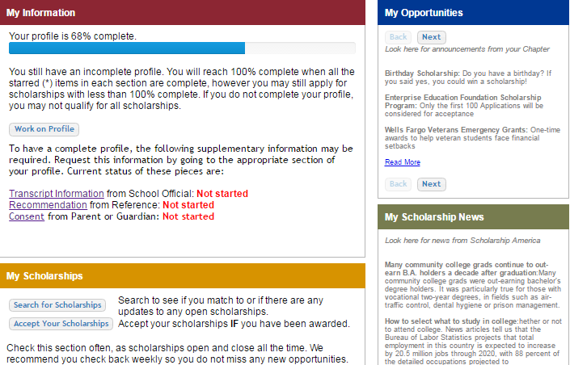
Student Profile: Finding Scholarships
When you’ve completed all your information, you may begin your scholarship search!

Slide 27
Verify Eligibility to Match to Scholarships
Your next step is to click on “Verify Eligibility for All Scholarships.” This matches you to scholarships for which you meet the eligibility requirements.
This search should be done regularly as new scholarships are added periodically.

Slide 28
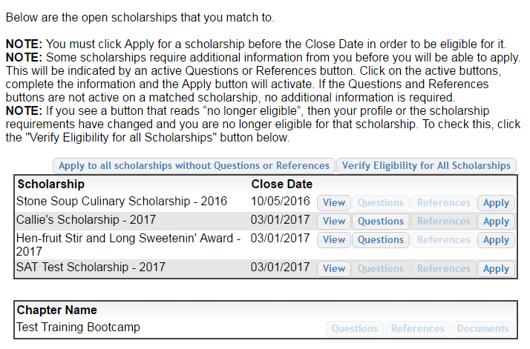
Student Profile: Scholarships!
Additional essay or reference information may be required before submitting some applications for certain scholarships. The “Apply” button will activate only once these are complete.
If no further information is required, the Apply button will already be active and available to click.
To be eligible for a scholarship, you MUST click the “Apply” button.

Slide 29
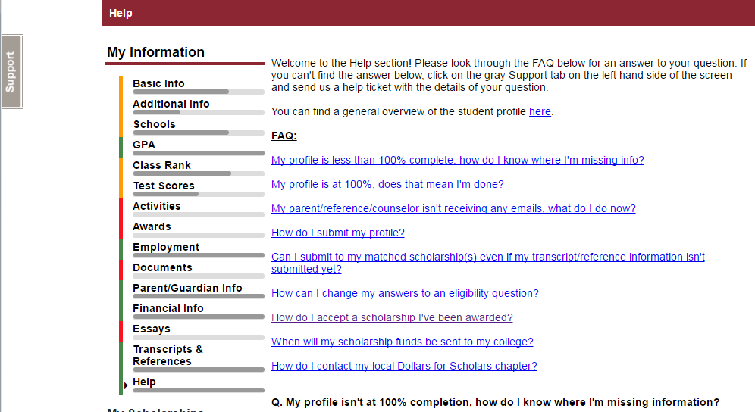
Need Help?
Check out the Help section for instructional documents and videos.
If you have any questions or need technical assistance, click on the support tab on the side of the page and enter a help ticket.
Email us at winnacunnetdfs@gmail.com

Slide 30
Access
You can get back to your profile at any time via the button on your local affiliate’s Students & Parents page.

