Slide 1
How to Apply for a Ballard Dollars for Scholars Scholarship

Slide 2
Who is Ballard Community Dollars for Scholars?
Providing scholarships for 28 years
Part of Scholarship America
Run by volunteers
Scholarships are funded by local supporters, businesses and alumni of the Ballard community
Everyone receives the same amount of scholarship money. The amount varies from year to year, depending on applications, fundraising, and other donations.
Notes:
You can receive a scholarship from our organization if you plan to further your education after you graduate. If you are even thinking about going to college or trade school, you can benefit from this.
Ballard is fortunate to have had a Dollars for Scholars chapter since 1995. Along with other Dollars for Scholars chapters at other schools, our chapter is under the umbrella of a national organization known as Scholarship America. BCDFS is simply a committee of interested community volunteers – often parents of Ballard students, who believe that post-secondary education is important.
We ask local businesses and individuals for money to provide scholarships for Ballard seniors. We are volunteering our time to help you be able to afford to go to college or trade school because we know it’s expensive and we know that post-secondary education leads to many opportunities.

Slide 3
How do I Qualify?
Senior at Ballard High School
Must attend college, university, trade school, or vocational training program
Must correctly apply online by the deadline – February 29, 2024
You have to apply to receive a scholarship!
Notes:
If you are getting a Ballard diploma this spring, you are eligible.
You must be planning to go to a college, university, junior college, trade school, vocational training program or other program that is accredited by the department of education.
You must fill out an on-line application by completing the required information by the deadline.
You must attend scholarship awards night in April to receive your scholarship and then go back into your application to accept it before you head off to school.

Slide 4
Important Dates
- Scholarship applications open December 1, 2023
- Scholarship applications deadline is February 29, 2024
You can make changes up until then, but you must have “applied” to your matched scholarships. Verify your eligibility!
- Scholarship Awards Night is in April
- Deadline to use scholarship is December 31, 2025
(or longer if you are entering the military after HS)
Notes:
Deadlines: You must apply between Dec 1, 2023 and Feb 29, 2024.
We must have your complete application (complete in terms of what Ballard requires), including you searching for, matching to and APPLYing for scholarships by that date.
Come to scholarship awards night to receive your scholarship. This is mandatory.
You have until December 31, 2025 to claim your scholarship so it’s ok if you take a year off to make money before going to college.

Slide 5
ballard.dollarsforscholars.org
Select ‘students & parents’ tab at far right
Notes:
To get started, you will go to the website ballard.dollarsforscholars.org and choose the students & parents tab.

Slide 6
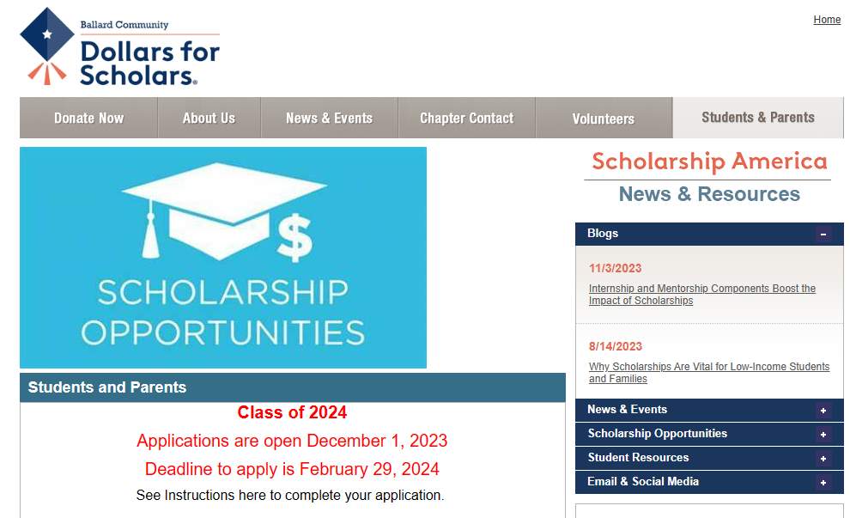
Notes:
And the students & parents tab is on the far right. There is information in this area that you can read at another time, but for now, …

Slide 7
Scroll down to the bottom & Click to Login
Notes:
Here it is at the very bottom of the page

Slide 8
Create account and login with an email address & password in ChapterNet
DO NOT USE BALLARD EMAIL ADDRESS!
- You will need to access this after you graduate
Fill out the application sections required
- Don’t have to finish all at once. Save your progress.
- Create only one account (use same log in each time)
Notes:
The first thing you are going to do is create an account. For this account, you will be entering an email address for how we contact you. You will NOT use your Ballard student email address. You will need an email address that you can check that is NOT your Ballard email address because your Ballard address will be cut off after you graduate, but we are going to need to continue to communicate with each other about your scholarship at least into the summer. I know most of you don’t use email much anymore, but if you want to get a scholarship from us, you’re going to have to use it for a few months, at least because that is how ChapterNet works.
Once your account is set up, you will start filling out the different sections of the application. Keep in mind, you can go back to your application and add to it or change it up until the deadline. Please make sure you always use the same account so you don’t have 2 or 3 different applications going at once. So, you’re going to have to remember the email address and password you use.
Ok, now we are ready to get going in ChapterNet.
Any questions at this point before we have you start creating your account?

Slide 9
Do not use your school address. Remember your password!
Notes:
The first time you go to log in, you will have to create your account. This will send instructions to the email address you choose. Do NOT use your school email address. You’ll need to access this site after your graduate.
For subsequent log-ins, you will use the box at the bottom of the screen.
Remember your password! We do not have access to retrieve or reset your password. If you forget it, you’ll need to start a new profile.

Slide 10
Choose Ballard Community Senior High School in Huxley
Notes:
Once you’ve hit the button to create an account, this screen will come up for you to enter your high school into. There are over 29,000 schools in their data base, but if you start typing Ballard in the school name blank, choose the Ballard Community Senior High School in Huxley Iowa and hit submit at the bottom

Slide 11
Complete with your information. You will need to enter 3 schools you are interested in attending. These can be changed later if needed.
Notes:
Enter your contact information. You have to at least fill out all the blanks with a double asterisk. Here is where you are choosing an email address that is NOT your Ballard school email address.
Enter your top 3 schools you are interested in attending after you graduate. This is your best guess at this point – it is not set in stone and you can change these later if needed.
Be sure to tick the box by the red information at the bottom which says you are aware that we will be looking at your scholarship application for the purpose of awarding you a scholarship.
Click submit at the bottom.

Slide 12
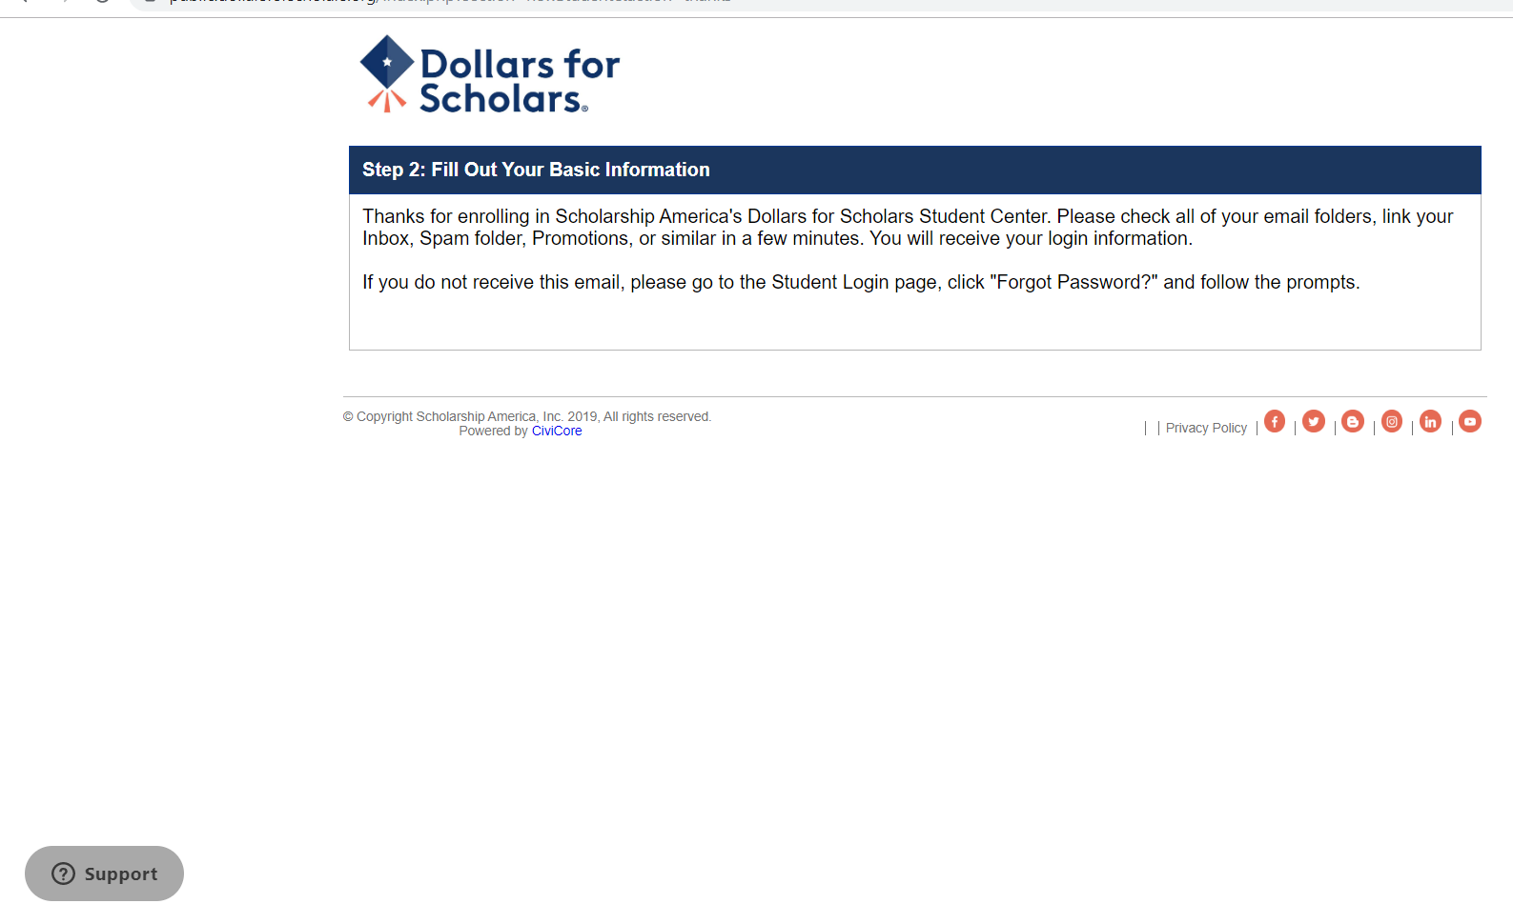
You should get to a screen like this that instructs you to check your email for login instructions. Proceed as instructed.
Notes:
You will get a screen like this that instructs you to check for an email at the address you provided us and follow the instructions to log in with the password they give you and set a new password. This will allow you to finish setting up your account.

Slide 13
Once you’ve reset your password, come back to this screen. Finish completing the required fields, save and continue.
Notes:
When you’ve reset your password to one you want and clicked submit, you come back to this page with your contact information. Now, notice however, the computer recognizes you and has information in the upper right corner pertaining to you. It should say that your are matched to Ballard Community Dollars for Scholars and National DFS Scholarships. Finish filling out any double asterisk items and at the bottom, you are going to click on save and continue.

Slide 14
Your account is now set up. Select the “Work on Profile” button to continue.
Notes:
This takes you to your dashboard where you will be taken to after you log in from now on since now your account is now set up. From your dashboard, you can continue to work on your profile.

Slide 15
Click on “Search for Scholarships” after your application is complete to find scholarships to match to.
Notes:
When you are done with your profile, you can come here and “search for scholarships”. You will be using this button after your application is complete to tell the computer to find scholarships you match to.

Slide 16
You can apply for national scholarships by opening the ‘My Opportunities’ section to learn more. Your DFS application does NOT automatically submit you to other scholarships.
Notes:
On the right side of your dashboard is news and information from SA, our parent organization. Of particular interest is the section called “My Opportunities” which shows you national scholarships that you can apply for using this same application. Filling out your application for Ballard does NOT automatically apply you to national scholarships. National level scholarships will each have their own requirements and deadlines, and you will likely be required to fill out more sections of the application for consideration for a national scholarship.

Slide 17
Click on ‘Work on Profile’ to get started.
Notes:
Click on ‘Work on Profile’ so you can fill out the rest of the application.

Slide 18
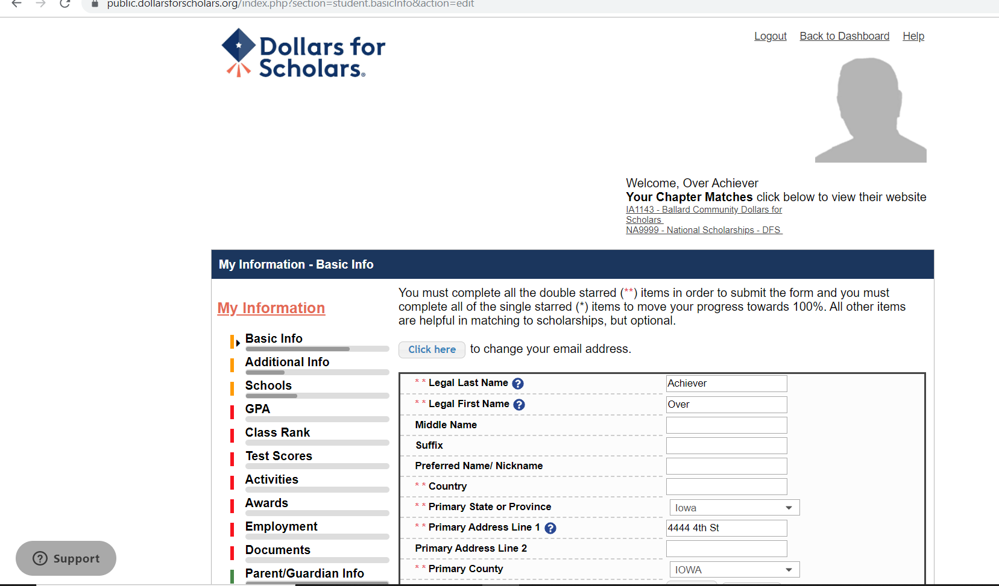
Review and complete Basic Info. Choose ‘Save and Continue’ to go to the next section. Or choose ‘Save and Go To Dashboard’ to save for later.
Notes:
You get this screen which is the first section of the application which is the basic information section. Notice it is already populated with information you entered when setting up your account. You will want to finish answering any double asterisked questions in this section and then move on to the next section.

Slide 19
Continue on for each section that is required. See next slide for sections that are required.
Notes:
So that is basically how you fill out your application. You go from section to section, completing the ones we ask you to, including answering all the double asterisk questions WITHIN that section. However, the good news is, we DO NOT require that you fill out all the sections in the application. So which ones do we require?

Slide 20
REQUIRED
You must answer everything with an ** in:
Basic information
Additional information
Schools/majors you are considering (Top 3)
Activities (sports, church, volunteer, clubs, music, theater, etc.) - Elaborate with details
Employment - Elaborate with details
Notes:
On this slide are the sections we DO require you to fill out.

Slide 21
Additional Info screen – be sure to answer the ** questions
Notes:
The way you can tell what section you are working in is by this left column. Look for the little toggle mark. You can go through the application in order or skip directly to a section by clicking on it in the left column. You can see this is the additional info screen where there are only a couple more questions with double asterisks that you haven’t already answered. Just like before, fill it out, when you get to the bottom, hit save and continue.

Slide 22
Enter high school information. Enter your top 3 school choices and 3 majors. These are not official, just use your best guess what you are interested in.
Notes:
Answer the grade level, graduation year and school and then move down to the schools and majors part.

Slide 23
This screen is used to help match scholarships so fill out what you can. Two year schools and trade schools also count for further education, not just colleges listed.
Notes:
Notice it does call this subsection college information. Remember, you can get a scholarship from us for going to a junior college like DMACC or a trade school such as electrician school, cosmetology school, HVAC school, etc., too, not just 4 year colleges. Notice much of this is not double asterisked. But, you will get sorted as eligible for more of our scholarships if you enter this information because some of our scholarships have a preference of a certain school or major. For example, you will not be eligible for a scholarship that prefers a student going into accounting if you haven’t entered accounting in your top 3 most likely majors. Near the bottom when it starts asking about college you currently attend, etc., you don’t need to answer those, even if you are taking classes at Iowa State when in high school. The chapternet system is set up to be used by dollars for scholars chapters that also offer scholarships once you are in college.

Slide 24
You can search for a major or look in the list.
Notes:
When you click on major, the list of majors comes up and you can scroll through them or just start typing your major in at the top search box.

Slide 25
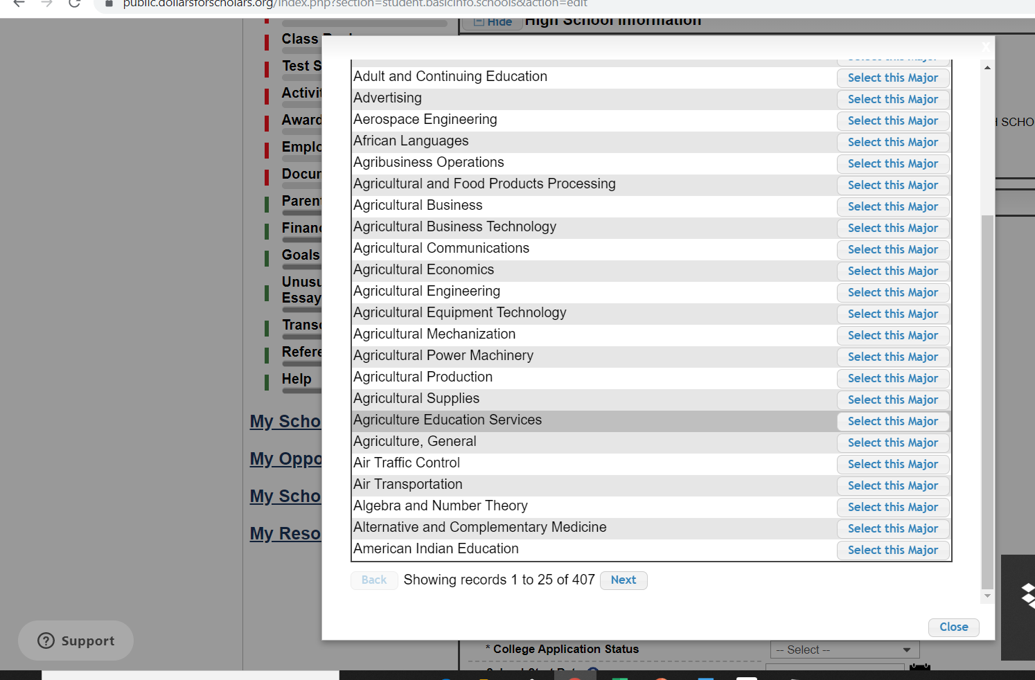
Use Next to search more pages. Save and Continue when finished.
Notes:
At the bottom of each page is how you load the next page. Once you’ve got your majors in and finished with the schools section, save and continue to the next section.

Slide 26
Complete the GPA section. You will not be denied a scholarship due to GPA, but it may help match you to a scholarship with certain criteria.
Notes:
Here is the GPA section. There are many ways to look at GPA’s, so we would like to get everyone using the same comparable numbers.

Slide 27
Select ‘I have high school GPA information only’
Notes:
Here you say GPA is available for high school only.

Slide 28
Do NOT check ‘My school uses weighted GPAs.’ Check ‘My school used the same GPA scale for all grade levels. Enter your current cumulative HS GPA, and the scale is 4.00
Notes:
and DO NOT check that Ballard uses weighted GPAs. Instead make sure that it is checked that your school uses the same GPA scale for all grades.
Then, the only GPA you need to enter for our use is your current cumulative HS GPA and that the scale is 4.00.

Slide 29
Do not answer the Class Rank or Test Scores questions. Choose Save and Continue.
Notes:
The next section is your class rank. We do NOT require that you enter your class rank because we won’t use it in determining eligibility for any of our scholarships. So you can not answer the question, but just choose save and continue at the bottom. You can do the same for the next section called test scores. We do not need to you enter any information in the test score section because we don’t look at it. None of our current scholarships have a preference about your ACT or SAT scores.

Slide 30
Add details to the Activities section – how many hours you spend, how many years you’ve been involved, your role in a club or on a team, etc. Activities and/or Employment is a Ballard DFS requirement.
Notes:
So, in the activities section, click on the enter activity button. It will ask “do you have activities to enter? Say Yes.

Slide 31
Activity Types in ChapterNet (Not Paid)
Athletics (in or outside of school; club teams)
Church-related activities (mission trips, volunteer Sunday School classes, help in nursery or at VBS)
Community volunteer activities (clothes pantry, ditch cleanup, habitat for humanity, help at Iowa Games)
Clubs and organizations (Boy Scouts, 4-H, game changers, chess club, student council)
Fine arts (theater, speech contests, dance in the nutcracker production, community chorus)
Notes:
ChapterNet puts activities in 5 categories and these are things you did for which you were not paid. Notice, they are not just school activities. You might save some time if you think about your activities ahead of time and how to categorize them before sitting down to enter them in your application.

Slide 32
Complete the highest level of activity that you participated. For example, choose Varsity if you played for one year, even if you also played Junior Varsity.
Notes:
Choose the highest level you attained. In other words, if you played JV for two years, but made varsity your last two years, choose varsity. If you played on a club team outside of school, select that option.

Slide 33
Fill out a brief description of the activity and enter the organization name.
Notes:
Then fill out a brief description of the activity and if it was a school sport or club, enter Ballard High School as the organization name. If it was 4-H, choose your club name. If it was dance classes, choose your studio name.

Slide 34
You can add awards, honors, or offices if you’d like, but not required. Save and add another activity or click submit.
Notes:
And lastly, if you want to, you can put awards, honors, offices you received or held with this activity, you may enter them, but we will not use that information. Click save and add another activity at the bottom, or, when you’ve added your last activity, click submit.

Slide 35
You can review what you have entered for Activities. Save and Continue to go on.
Notes:
That will sent you back to a screen of your list of activities you entered and you can then save and continue like you did in other sections.

Slide 36
Awards are not required. Click Save and Continue.
Notes:
The next section is awards, which you don’t have to fill out for us so click save and continue.

Slide 37
Complete Employment section if you have work experience.
Notes:
The employment section is where you will add any work experience for which you were paid during your high school years. It works a lot like the activities section in that it asks where you worked, how many hours, and your wage.

Slide 38
Complete this page for each position you held for employment. Save and add another, or click submit when done.
Notes:
So fill it out for each of your jobs and click submit when they are all entered.

Slide 39
Complete with as much information as possible. Reminder – Activities and/or Employment is required for DFS. This will help you match to scholarships in the system.
Notes:
Again you will then get a summary list of what you entered. Save and continue. Remember, at Ballard, we require you to have something in the activities section and/or the employment section, or your application is considered incomplete. And if you fail to put in the activities section that you played basketball at Ballard and then you say yes to the preference question about did you play on the basketball team for at least 2 years during high school, I may remove your application from eligible for that scholarship because your didn’t put basketball as one of your activities. By the way, filling the activity and employment sections with more detail can be useful to you down the road when you need to make a resume, because you will have all this information already listed out to refer back to.

Slide 40
REQUIRED
You must at least answer everything with an ** in:
Basic information
Additional information
Schools/majors you are considering (Top 3)
Activities (sports, church, volunteer, clubs, music, theater, etc.) - Elaborate with details
Employment - Elaborate with details
Parent/Guardian Info is optional but good idea.
(Only to be used if we need another way to contact you.)
Notes:
The Parent/Guardian Info section is optional. We wouldn’t use the information in this section unless we have problems contacting you about your application or scholarship.

Slide 41
The other sections listed are not required for Ballard DFS.
Notes:
There are several more sections, but we don’t make you fill them out for our Ballard scholarships.

Slide 42
Parent/Guardian Info is optional.
Notes:
Fill out the parent info if you want and that is the last section that we are interested in so then you can click save and go to dashboard.

Slide 43
Your dashboard won’t say 100% complete because you are not required to complete every section. That’s ok. Click on ‘Search for Scholarships’ when you are finished entering information.
Notes:
Or, if you scroll down a on your dashboard page, when you are completely finished with your application, you can search for scholarships. NOTICE that the computer says your application is not 100% complete. That is ok. We did not make you fill out all sections, so it probably won’t say 100% complete, even when you are finished completed our required sections.

Slide 44
In the ‘My Opportunities’ section, you can look for national scholarships.
Notes:
You can search for national scholarships in the my opportunities section on the right side of your screen. Click the read more button to find out more.

Slide 45
Each national scholarship will have their own requirements. When finished, click on Back to Dashboard.
Notes:
That will send you to a list of national scholarships that you can investigate. Each national scholarship will have it’s own requirements and deadlines, but you can use your application to apply for them. But, you might have to go back and fill out more in your application to be eligible for a given national scholarship. Then just click back to dashboard to get back from here.

Slide 46
Click on Search for Scholarships and answer the yes/no questions on the next page.
Notes:
This button tells the computer to sort you into scholarships for which you meet the preferences. Some preferences we can have the computer automatically sort you into such as “do you live in Kelley?” from your information you already gave us. But, some preferences are difficult to sort automatically for, so we have a few yes/no questions for you to answer for the remainder of the preferences.

Slide 47
When finished with yes/no questions, be sure to click Submit. If you click the Support button, it will send a ticket to the national organization of ChapterNet. For specific questions, ask Ms. Doland for help.
Notes:
This slide shows you to be sure to click submit when you have answered the yes/no questions. It also gives you instructions about what to do if you answered one incorrectly and want to go back and change it, you need to email the national dollars for scholars organization or click the gray support button in the lower left. You may have noticed that the support button is always present in the lower left corner in chapternet. Clicking that will allow you to submit a help ticket to the national organization about a problem or question relating to chapternet. They won’t be able to answer specifics about what Ballard requires in your application. Also, it may take them a couple days to get back to you. For Ballard specific questions, you need to contact Ms. Doland or ballarddfs@gmail.com.

Slide 48
After completing the questions, your screen should show scholarships for which you are eligible. Everyone should have at least one.
Notes:
After your answers to the preference questions are submitted, this is the screen you get. It lists all the scholarships for which you are eligible. Everyone should have a least one scholarship listed here, because everyone should match to the one called Dollars for Scholars scholarship which represents all our scholarships that have no preferences associated with them.

Slide 49
You’re STILL not done!
This Photo by Unknown Author is licensd under CC BY-SA-NC
Notes:
If you don’t do this last part, you still aren’t finished.

Slide 50
You MUST click ‘Apply’ for each scholarship you want to apply for. It’s best to apply for all scholarships listed, but only the Dollars for Scholars scholarship is required.
Notes:
You may and are encouraged to apply to all you matched to, but you will only end up receiving one scholarship. EVERYONE needs to apply to the one called Dollars for Scholars.

Slide 51
Read the disclosure listed here, type your name in the box and submit.
Notes:
You will get another page saying you agree to submit your application for us to review for the purpose of awarding you a scholarship, you provided truthful information and you agree to our scholarship policies such as you must use your scholarship by Dec 31, 2125 unless you are going into the military, etc. Type your name in the box and click submit.

Slide 52
The number of scholarships you’ve applied for will be listed here. If you missed any, you may still click apply until the deadline.
Notes:
Then you will come back to this page where you had the list of scholarships you matched to and applied to and notice they are not listed at the top now, they have moved down to the “scholarships I’ve applied for” area. If there are some you didn’t apply to, they will still be in the top section and you can choose to hit apply up until the deadline or not apply for it at all.

Slide 53
You can see the scholarships you’ve applied for here. After scholarship award night, your scholarship will be listed in the “scholarships I’ve been awarded”. After that, you will receive instructions on how to accept that scholarship.
Notes:
If you scroll down the page, there is the list of scholarships you’ve applied for. Again, you will end up only getting one of these. NOW, you are done. We keep it a secret which scholarship you are getting until awards night. Then after scholarship awards night in April, I will go back into chapternet and “award” the scholarship you received and it will then show up under “scholarships I’ve been awarded”. Then you will be advised how to go back into chapternet before you start college to accept the scholarship you were awarded.

Slide 54
Whew!! Your application is finally complete.
This Photo by Unknown Author is licensed under CC BY-SA-NC
Notes:
You made it. Sometimes a donor comes to us and wants to set up a new scholarship let’s say at the end of February and you’ve already completed your application. If the scholarship has a preference and you meet that preference, is it too late to get into that eligible pool? Not if you go back into your application, on the dashboard, go to the my scholarships section.

Slide 55
If you want to look for additional scholarships, you can click ‘search for scholarships’again
Notes:
And click the search for scholarships button again.

Slide 56
If you want to check for new scholarships (before the deadline), go the Search for Scholarships, and then ‘Verify Eligibility for All Scholarships’. If a new scholarship shows up, you’ll need to Apply for the new scholarships that you are eligible for.
Notes:
That will bring up this page where all the scholarships you applied to are now below that heading, but there is a button at the top where you can verify your eligibility in case new scholarships were added after you searched and applied to scholarships. This will pull you in to the pool of eligible applicants if you meet the preferences for this new scholarship. Then it will show up under scholarship applications to complete and you can click the apply button to apply for it. That doesn’t happen often, but it can, so it’s a good idea to verify your eligibility near the deadline date.

Slide 57
Be sure to go back to the dashboard and Logout when you are finished.
Notes:
So now back at your dashboard is where you can log out, continue to work on your profile (aka scholarship application) or,.

Slide 58
How to get help:
Ask Ms. Doland
Email ballarddfs@gmail.com
Click support tab for ChapterNet questions
See instructions link on website, Students & Parents tab
APPLY EARLY - DO NOT WAIT UNTIL THE LAST MINUTE!!!
Notes:
Here are ways you can get help or answers to your questions about filling out your application.
Ms. Doland will be visiting all the sections of Econ class on one day in January to help you finish up if you haven’t already. You can bring your questions that day.
You can email our committee at our email address. We may not check it every single day, but we will monitor it more frequently as we get closer to the deadline.
I suggest you pick up a handout today as you leave or get one in the office.
When in ChapterNet, you can click the support tab or the help button to get technical help.
You can go to the ballard.dollarsforscholars.org website, student and parents tab where you work on your application and there is a link to more detailed instructions you can download.

Slide 59
You may receive emails from ballarddfs@gmail.com if you have incomplete information. We’ll try to follow up to help you get these completed.
We do reject incomplete or late applications
Attending Scholarship Award Night is a requirement to receive a scholarship. Watch for event details in April.
Notes:
We want you to successfully apply, so we will remind you about upcoming deadlines in announcements so listen for them.
Once you start your application, we can email you things to remind you what you still have to do, so check for them at the email you are using for your account. The emails will usually come from me personally, rather than DFS or SA so don’t ignore them. I will always try to say DFS in the subject so you know its about your application.

Slide 60
Paying for college is hard.
Applying for a DFS scholarship is easy.
Let us know if we can help ballarddfs@gmail.com
Notes:
We realize this one scholarship won’t pay for all of your college expenses, but every scholarship you can secure makes college a little bit easier to pay for. Don’t pass up a DFS one where a local donor wants to help you succeed. Any questions?

