Slide 1
Completing the Transcript Information

Slide 2
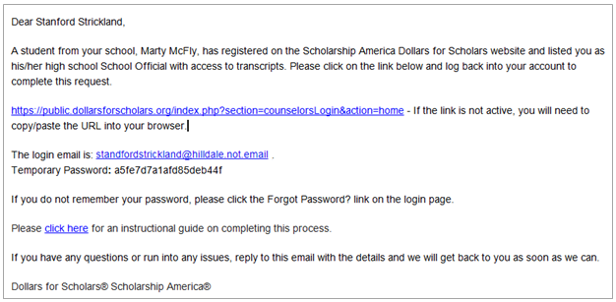
School Official Email and Link
Click the link provided in the email to access the School Official login page.

Slide 3
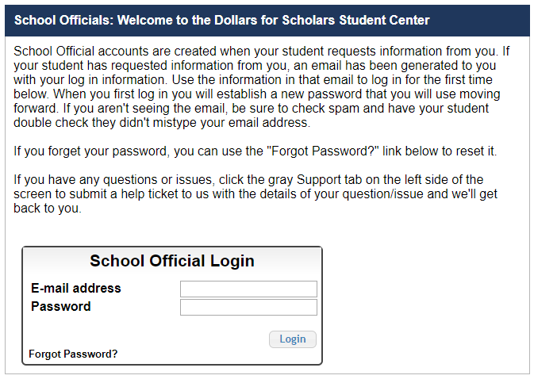
School Official Login Page
Please log in using the information provided in the email.
If a temporary password was not provided or you do not remember your password, click “Forgot Password?” to reset it.

Slide 4
Adding Transcript Information
Click “Add Transcript Information”.

Slide 5
Completing the Transcript Information Request
The student name is listed at the top of the form.
The Dollars for Scholars is listed along with the request type:
Transcript form
OR
Transcript Form & Transcript Upload**
** The Transcript Upload is only available when
required by the Dollars for Scholars.

Slide 6
Completing the Transcript Information Request
Fill in the form as much as you are able, or otherwise directed to by the local chapter.
You will need to scroll down to access all of the fields.
NOTE: You will need to enter the GPA and GPA Scale

Slide 7
Uploading the Transcript**
** The option to upload a transcript will NOT appear unless the local
Dollars for Scholars requires the upload.
At the bottom of the form you may either upload the transcript or check the box to indicate there is not one available.
Please verify the transcript is for the correct student before uploading the document.
When complete, click “Save and Submit Transcript Information Now”
If you need to submit later, click “Save and Submit Transcript Later” to save your progress.

Slide 8
Submitting Transcript Information
After clicking “Save and Submit Transcript Information Now,” the above box appears.
Check the box, then click “Submit” to complete the process.
Once you click “Submit”, you may only review the information but not make changes.
After submitting, you will receive a confirmation email.

Slide 9
Reviewing the Information
If you need to view the transcript that was submitted, click “Download”.
* The Transcript Information section is only available when required by a Dollars for Scholars.

Slide 10
Questions or Issues?
Please click “Support” at the bottom of the page at any time for Help Desk assistance.

