Slide 1
Your One-Stop-Shop for Cash for College
How filling out a single profile can lead to multiple scholarships.

Slide 2
The Basics to Earning Scholarships
Visit Sauk Centre Dollars for Scholars® website: saukcentre.dollarsforscholars.org
Complete the FREE online profile.
Match to scholarship opportunities from our local chapter.
Gain access to MORE scholarships from Scholarship America®.
Apply for scholarships!

Slide 3
Objectives
Learn how to access the student profile.
Learn the different components of the student profile.
Understand how to match and apply for scholarships.
Earn scholarships, attend college, and graduate!

Slide 4
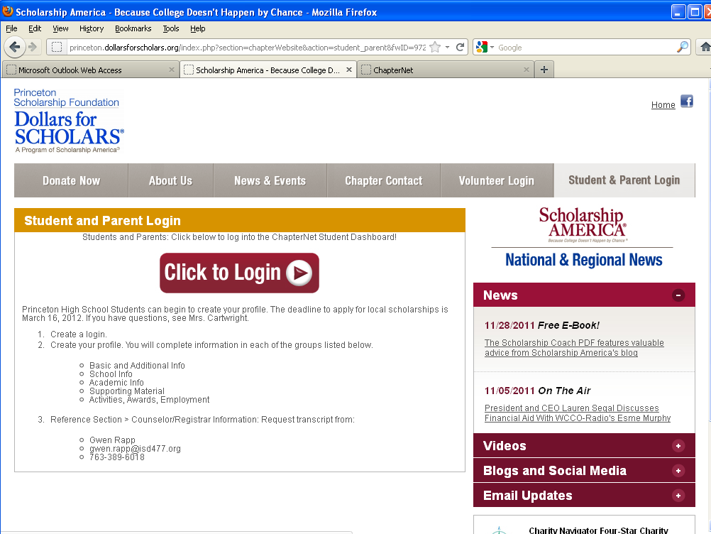
How to Access Scholarships
Visit Sauk Centre Dollars for Scholars chapter website.
Click on the Students & Parents tab.
Read/review the information on the page.
Scroll down to the maroon/white Login button.
Click to login.

Slide 5
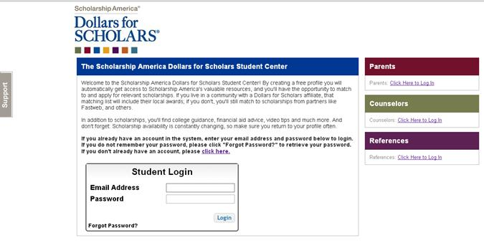
How to Access Scholarships
If you’re a new user, create your account here.
If you already have an account, log-in here.

Slide 6
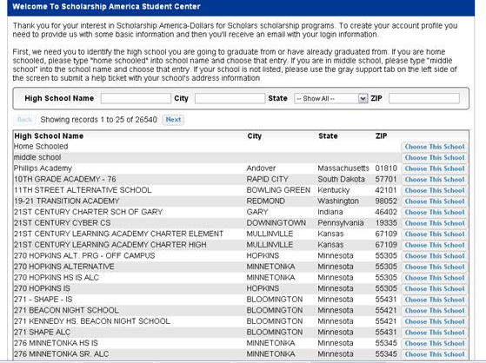
Creating Your Account
Start by entering Sauk Centre Secondary.
Click on “Choose This School” when our high school appears.

Slide 7
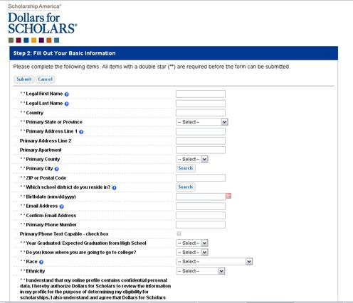
Creating Your Account
Start filling out your profile by entering your information.
Once this is complete, you will receive an email to verify your email address, and will then be directed to the student dashboard to establish your password.

Slide 8
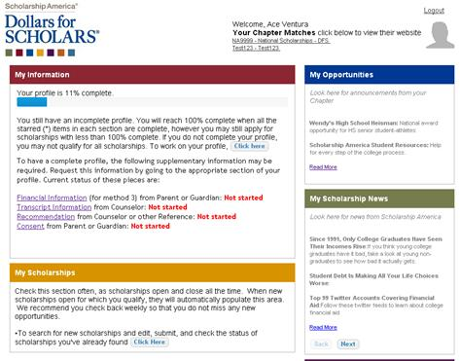
Welcome to the Student Dashboard!
The Student Dashboard lets you…
View your progress.
View local chapter matches and opportunities.
Link to national news and resources.
Search for scholarships!

Slide 9
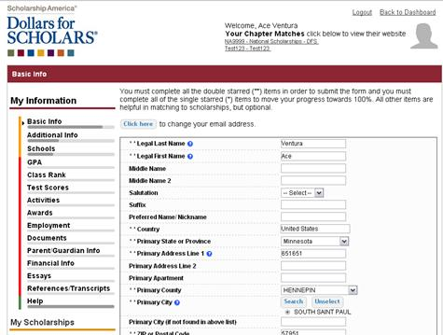
Your Student Profile
Click the links under “My Information” to edit or update sections of your profile. Notice the progress bars and color matches your level of completeness.

Slide 10
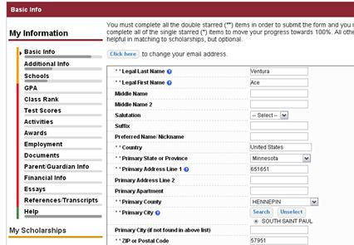
Student Profile: Basic Information
Items marked with a double star ** are required to move on from each section.

Slide 11
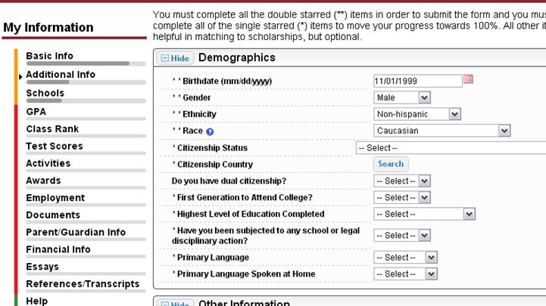
Student Profile: Additional Information
Items marked with a single star * are part of your status bars to show percent completion in each section.

Slide 12
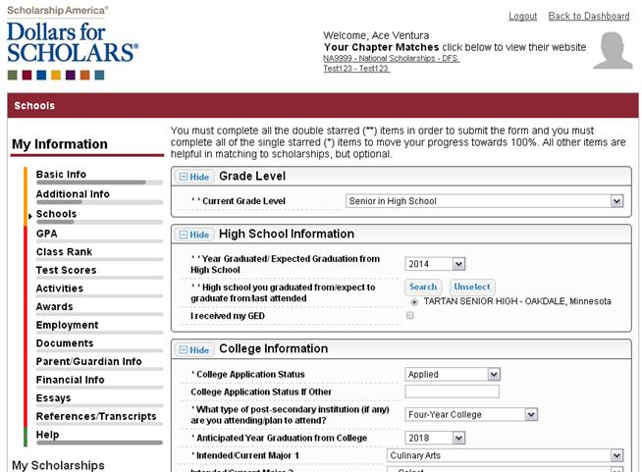
Student Profile: Schools
Be complete and accurate!
This will lead to more scholarship opportunities.

Slide 13
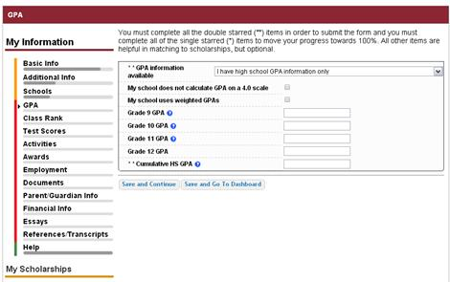
Student Profile: GPA
Accuracy is important!
Data will be compared to your transcript.
Select “I have High School GPA information only”
Enter cumulative GPA as of the end of Q2
GPAs for grade levels are not required, but may be entered

Slide 14
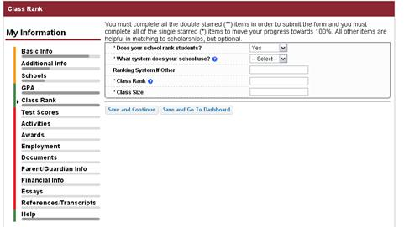
Student Profile: Class Rank
Class Rank is used along with GPA information.
Our school ranks students using Integers
Request your class rank from Ms. Endersbe

Slide 15
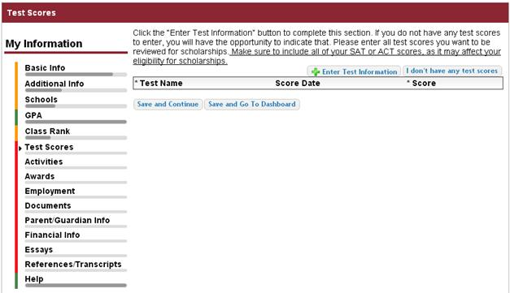
Student Profile: Test Scores
Click this button to enter ALL your information!
Inputting your ACT score will give you the best opportunity at receiving a top scholarship.

Slide 16
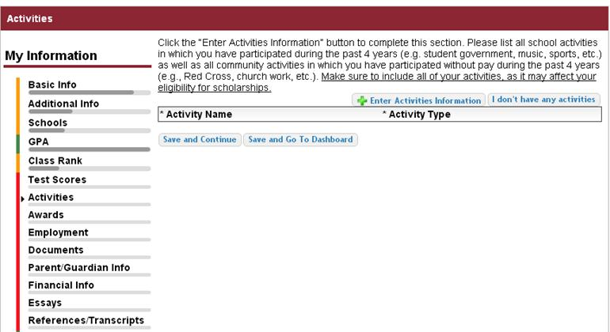
Student Profile: Activities
Enter ALL school and non-school related extra curricular activities (church, sports, volunteering, etc.).
Only enter activities that you have been involved in during the last 4 years (grades 9-12).
If you know you will be involved in a Spring activity, you may include it
Scoring depends on the completeness of your profile.

Slide 17
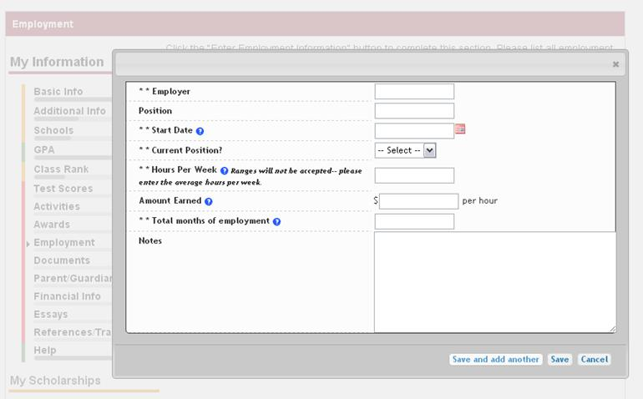
Student Profile: Employment
Enter all your employment information for the last 4 years (grades 9-12).

Slide 18
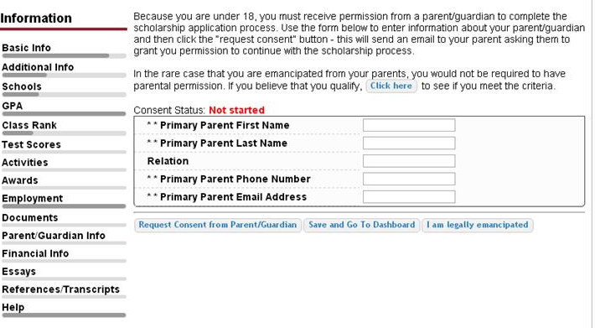
Student Profile: Parent/Guardian Information
If you’re under 18, you need parental consent to apply for scholarships. Enter your parent information and request consent. The parent will receive an email with a link that will give them the opportunity to grant consent.
If you are over 18, you do not need consent but can still enter your parent information.

Slide 19
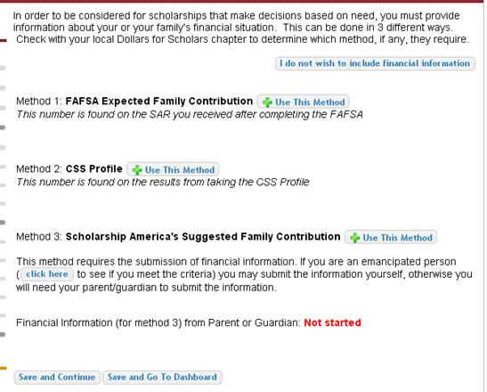
Financial Information
Our chapter does not require financial information because we are a merit based, not needs based scholarship.
The screen you see will not look like this screen. Instead, it will say: The chapters you are matched to do not require financial information, you do not need to provide anything in this section. Just choose to Save and Continue.

Slide 20
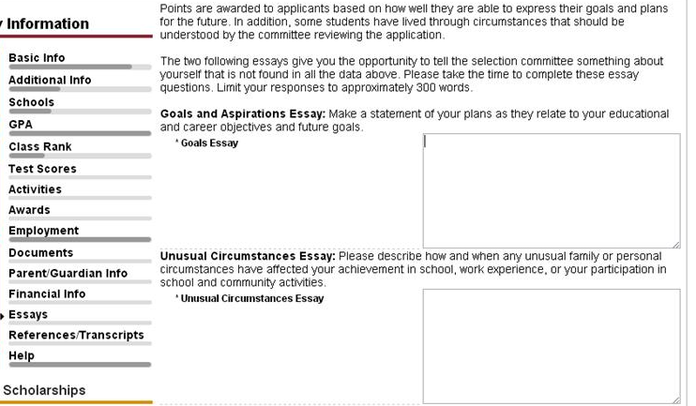
Student Profile: Essays
Provide a 300 word essay on your goals and aspirations. This Essay is REQUIRED for our chapter (even though it only has one *).
Provide a 300 word essay on any unusual circumstances you may have experienced in your life. This essay is Optional.

Slide 21
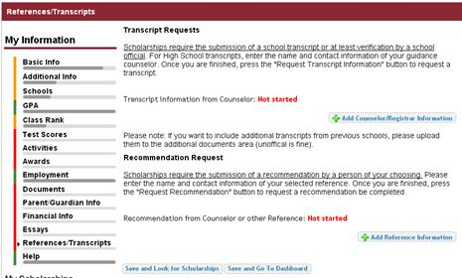
Student Profile: Transcripts & References
Click to add your counselor information to request transcript information. Our counselor is Hayley Endersbe and her email is: Hayley.endersbe@
isd743.org
A Reference or Recommendation is optional. Our local chapter does not require a reference.

Slide 22
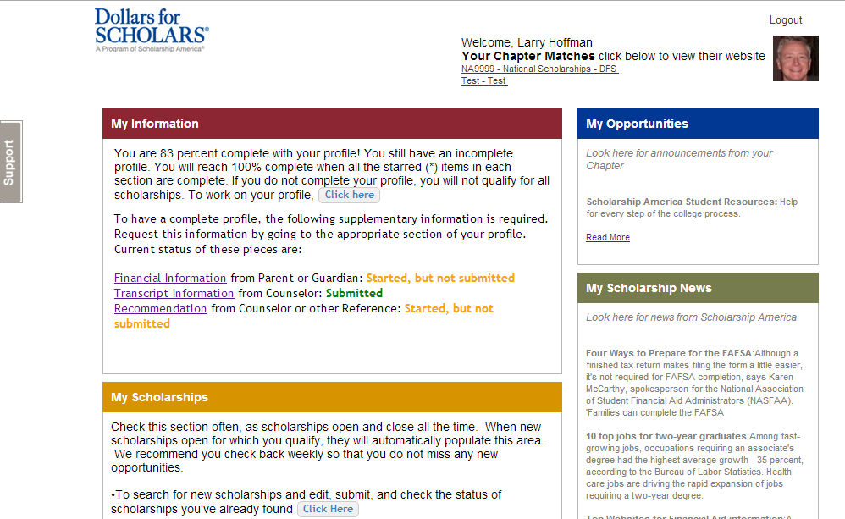
Student Profile: Finding Scholarships
After completing your profile as much as possible, begin your scholarship search here.
New local scholarships will be added periodically, so be sure to search for scholarships just prior to the March 2nd deadline.

Slide 23
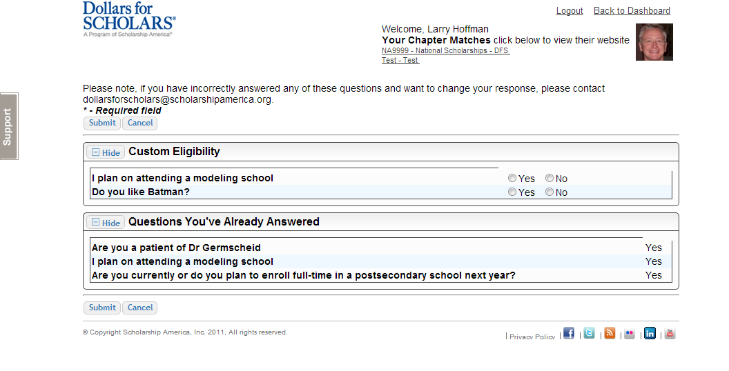
Student Profile: Scholarship Matches
If any scholarships you match to contain any custom eligibility questions, you will need to answer them first.

Slide 24
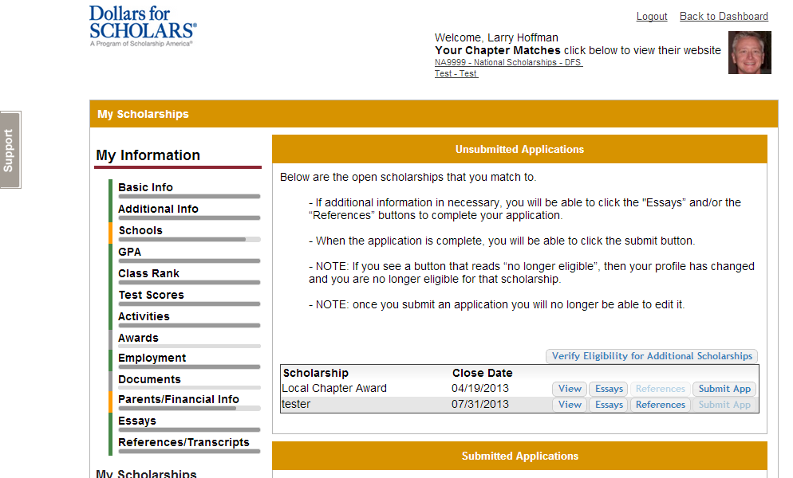
Student Profile: Scholarships!
Additional essay or reference information may be required before submitting some applications.
Double check that your profile is as complete as possible.
To submit for a scholarship, you MUST click the “Submit App” button!

Slide 25
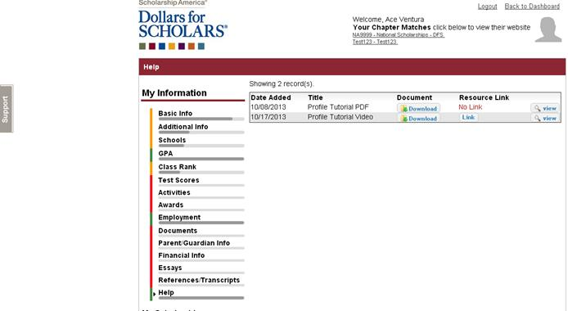
Need Help?
Check out the Help section for instructional documents and videos.
If you have any questions or need technical assistance, click on the gray support tab and enter a help ticket.

Slide 26
Access
Return to this page regularly to update your profile and view scholarship opportunities.
Parents, counselors and references would also login from here.

