Slide 1
Your One-Stop-Shop for Cash for College
How filling out a single profile can lead to multiple scholarships.

Slide 2
The Basics to Earning Scholarships
Visit: http://excelbeyond211.dollarsforscholars.org website.
Complete the FREE online profile.
Match to scholarship opportunities from local chapters, if available.
Gain access to MORE scholarships from Scholarship America®.
Apply for scholarships!

Slide 3
Objectives
Learn how to access the student profile.
Learn the different components of the student profile.
Understand how to match and apply for scholarships.
Earn scholarships, attend college, and graduate!

Slide 4
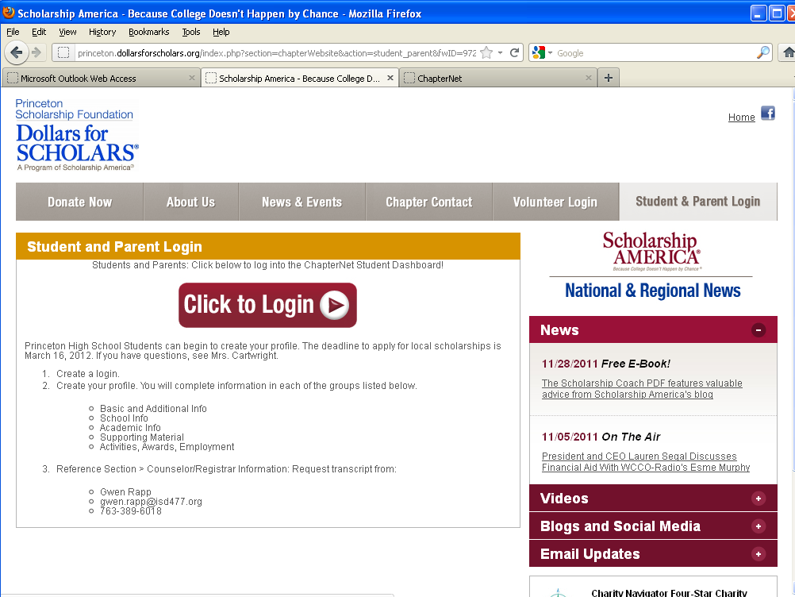
How to Access Scholarships
Visit ANY chapter website.
Click on the student & parent login tab.
Click to login.

Slide 5
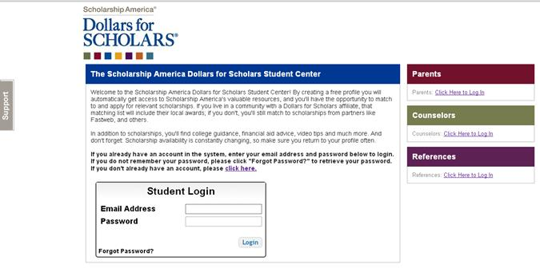
How to Access Scholarships
If you’re a new user, create your account here.
If you already have an account, log-in here.

Slide 6
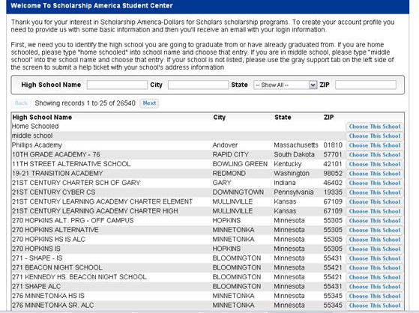
Creating Your Account
Start by entering the name of your high school.
If your school name returns too many results, you can filter by the city/state/zip code your school is located in
Click on “Choose This School” when your high school appears.

Slide 7
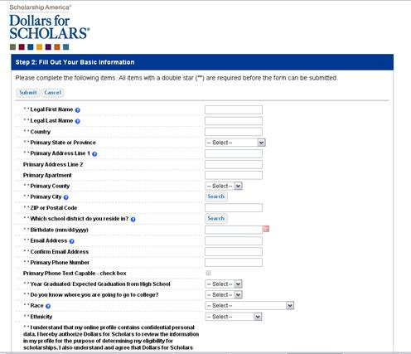
Creating Your Account
Start filling out your profile by entering your information.
Once this is complete, you will receive an email to verify your email address, and will then be directed to the student dashboard to establish your password.

Slide 8
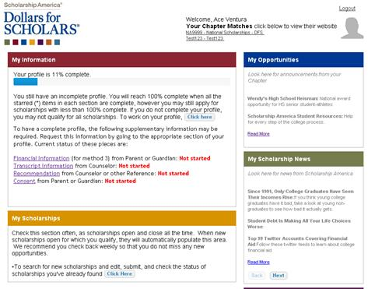
Welcome to the Student Dashboard!
The Student Dashboard lets you…
View your progress.
View local chapter matches and opportunities.
Link to national news and resources.
Search for scholarships!

Slide 9
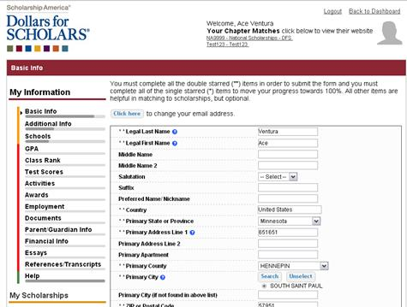
Your Student Profile
Click the links under “My Information” to edit or update sections of your profile. Notice the progress bars and color matches your level of completeness.

Slide 10
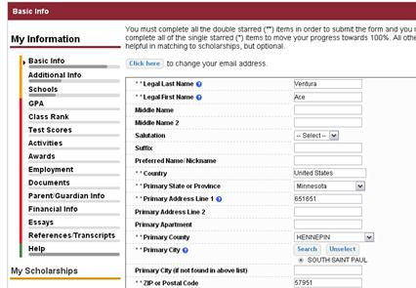
Student Profile: Basic Information
Items marked with a double star ** are required to move on from each section.

Slide 11
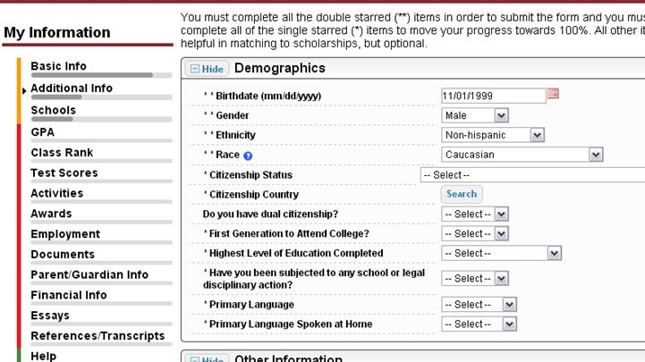
Student Profile: Additional Information
Items marked with a single star * are part of your status bars to show percent completion in each section.

Slide 12
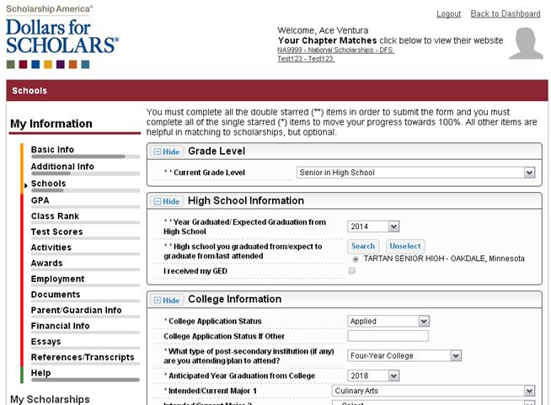
Student Profile: Schools
Be complete and accurate!
This will lead to more scholarship opportunities.

Slide 13
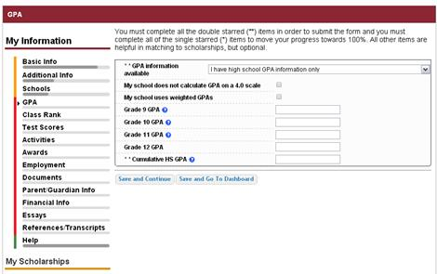
Student Profile: GPA
Accuracy is important!
Data will be compared to your transcript.
To convert percentages to a 4.0 scale, click the box “My school does not calculate GPA on a 4.0 scale.”

Slide 14
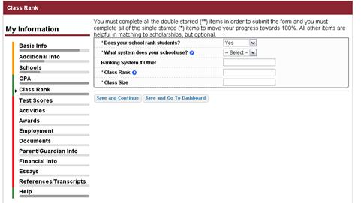
Student Profile: Class Rank
Class Rank is used along with GPA information.
If your school ranks students, you will need to indicate the system used
If your school does not rank students, select “No”.

Slide 15
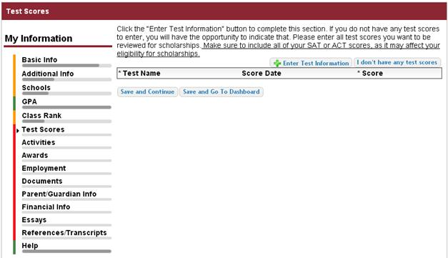
Student Profile: Test Scores
Click this button to enter ALL your information!

Slide 16
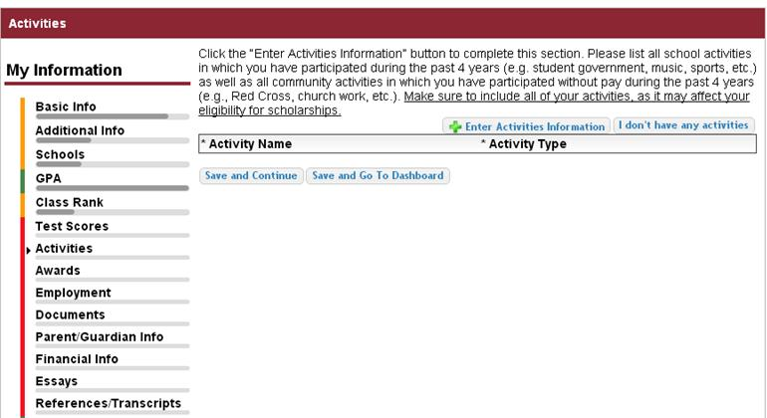
Student Profile: Activities
Enter ALL school and non-school related extra curricular activities (church, sports, volunteering, etc.).
Scoring depends on the completeness of your profile.

Slide 17
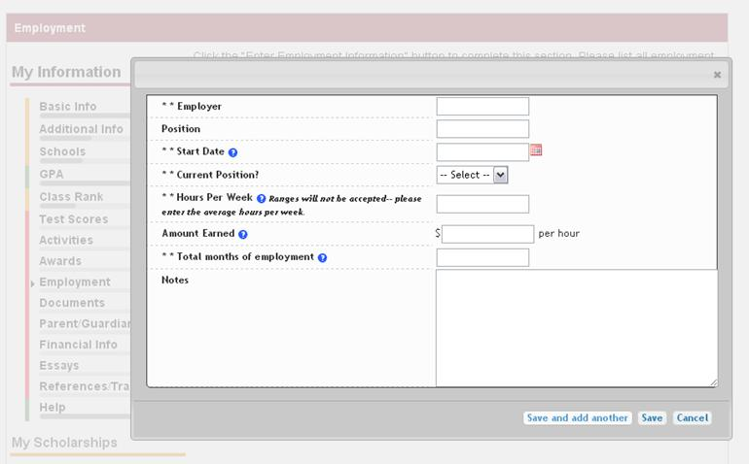
Student Profile: Employment
Enter all your employment information.

Slide 18
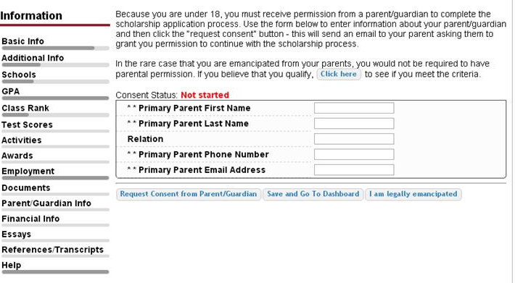
Student Profile: Parent/Guardian Information
If you’re under 18, you need parental consent to apply for scholarships. Enter your parent information and request consent.
If you are over 18, you do not need consent but can still enter your parent information.
If you are under 18 but legally emancipated you can click here.

Slide 19
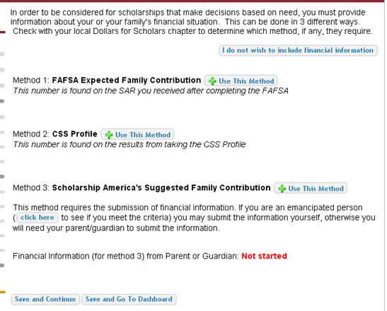
Financial Information
In order to be considered for needs based scholarships, you need to have financial info in your profile.
There are three different methods of financial info, you can use one or all of them. Check with your local chapter to confirm which method they use.
If you do not want to be eligible for needs based scholarships, you can click the “I do not wish to include financial information button”.

Slide 20
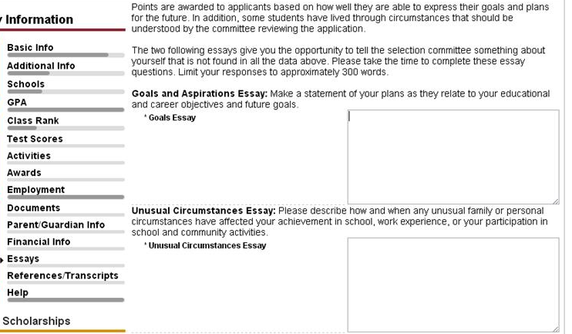
Student Profile: Essays
Provide a 300 word essay on your goals and aspirations.
Provide a 300 word essay on any unusual circumstances you may have experienced in your life.

Slide 21
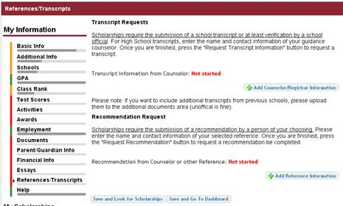
Student Profile: Transcripts & References
Click to add your counselor/registrar information to request transcript information.
Click to add reference information to request a recommendation.

Slide 22
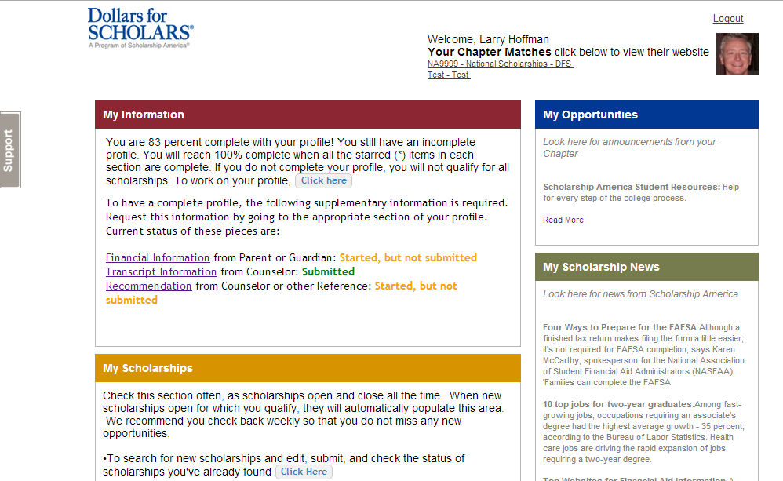
Student Profile: Finding Scholarships
After completing your profile as much as possible, begin your scholarship search here.

Slide 23
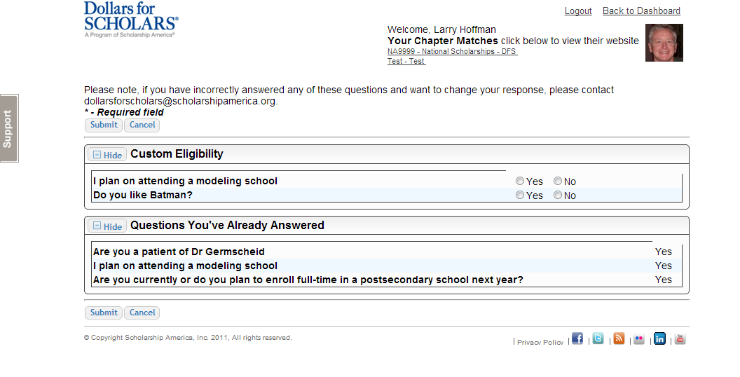
Student Profile: Scholarship Matches
If any scholarships you match to contain any custom eligibility questions, you will need to answer them first.

Slide 24
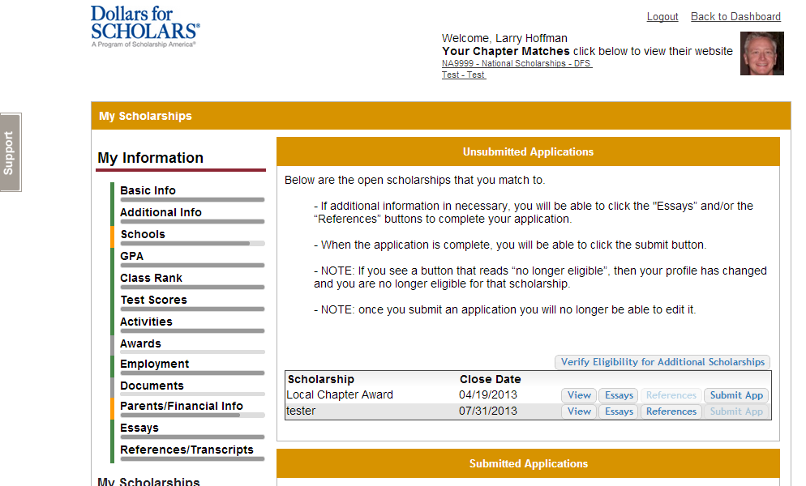
Student Profile: Scholarships!
Additional essay or reference information may be required before submitting some applications.
Double check that your profile is as complete as possible.
To submit for a scholarship, you MUST click the “Submit App” button!

Slide 25
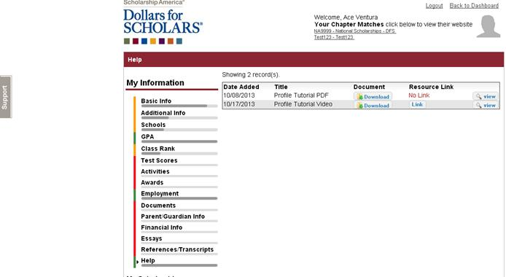
Need Help?
Check out the Help section for instructional documents and videos.
If you have any questions or need technical assistance, click on the gray support tab and enter a help ticket.

Slide 26
Access
Return to this page regularly to update your profile and view scholarship opportunities.
Parents, counselors and references would also login from here.

