Slide 1
Parent Portion of the
Student Profile
H O W P A R E N T S C A N C O M P L E T E T H E C O N S E N T F O R M A N D F I N A N C I A L
I N F O R M A T I O N P O R T I O N O F T H E S T U D E N T P R O F I L E .

Slide 2
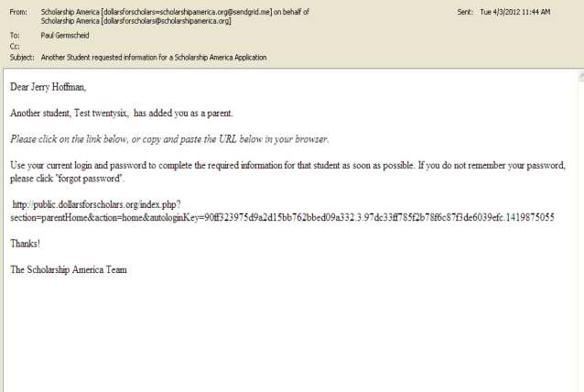
Parent Email & Link
As the parent, you have received this email with instructions. (If you did not receive this email, please check your spam folder.)
The parent must click on the link (or copy and paste the text) provided in the email in order to submit the proper information.

Slide 3
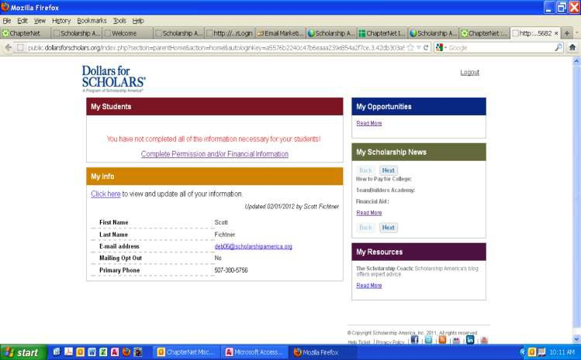
Parent Log-in Page
The link provided in the email will send the parent to the log-in page.
If it is the first time, they you will need to create a password.
After logging in, click on the link “Complete Permission and/or Financial Information.”

Slide 4
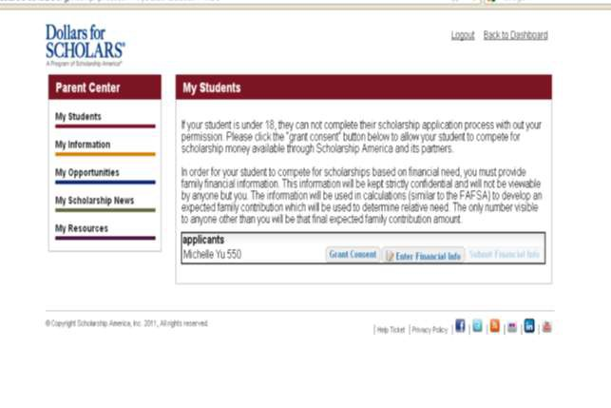
Granting Consent for Minors
If your child is under 18, you must click on “Grant Consent.”
If not, the button will not be there and you can skip this step.

Slide 5
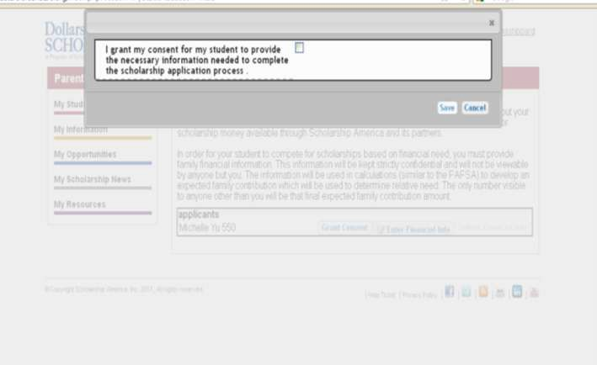
Granting Consent for Minors
After selecting “Grant Consent,” a box will appear. Click on the check box to grant your consent and allow your student to complete their scholarship profile.

Slide 6
Entering Financial Information
After granting consent, you can also complete the financial information.
This is may be needed to compete for needs-based awards.
Click on the link “Enter Financial Info”.

Slide 7
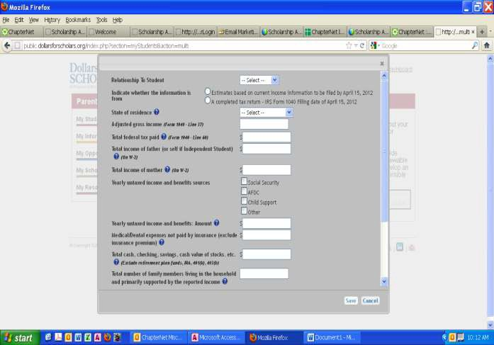
Entering Financial Information
Enter the information using the drop down boxes.
Be sure to scroll down to ensure that all questions are answered.
Click “Save” when fields have been completed.

Slide 8
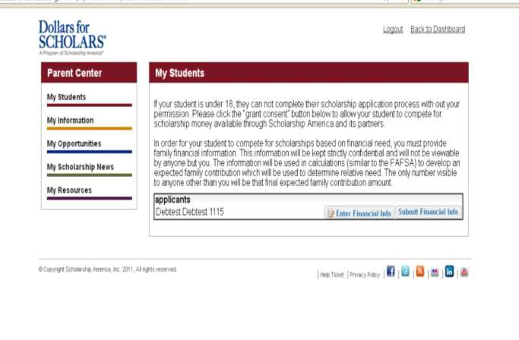
Submitting Parent Information
After clicking Save, you will be returned to this screen.
To complete the process, click on “Submit Financial Information”
After submitting, you will receive a confirmation email.

